Slide 1
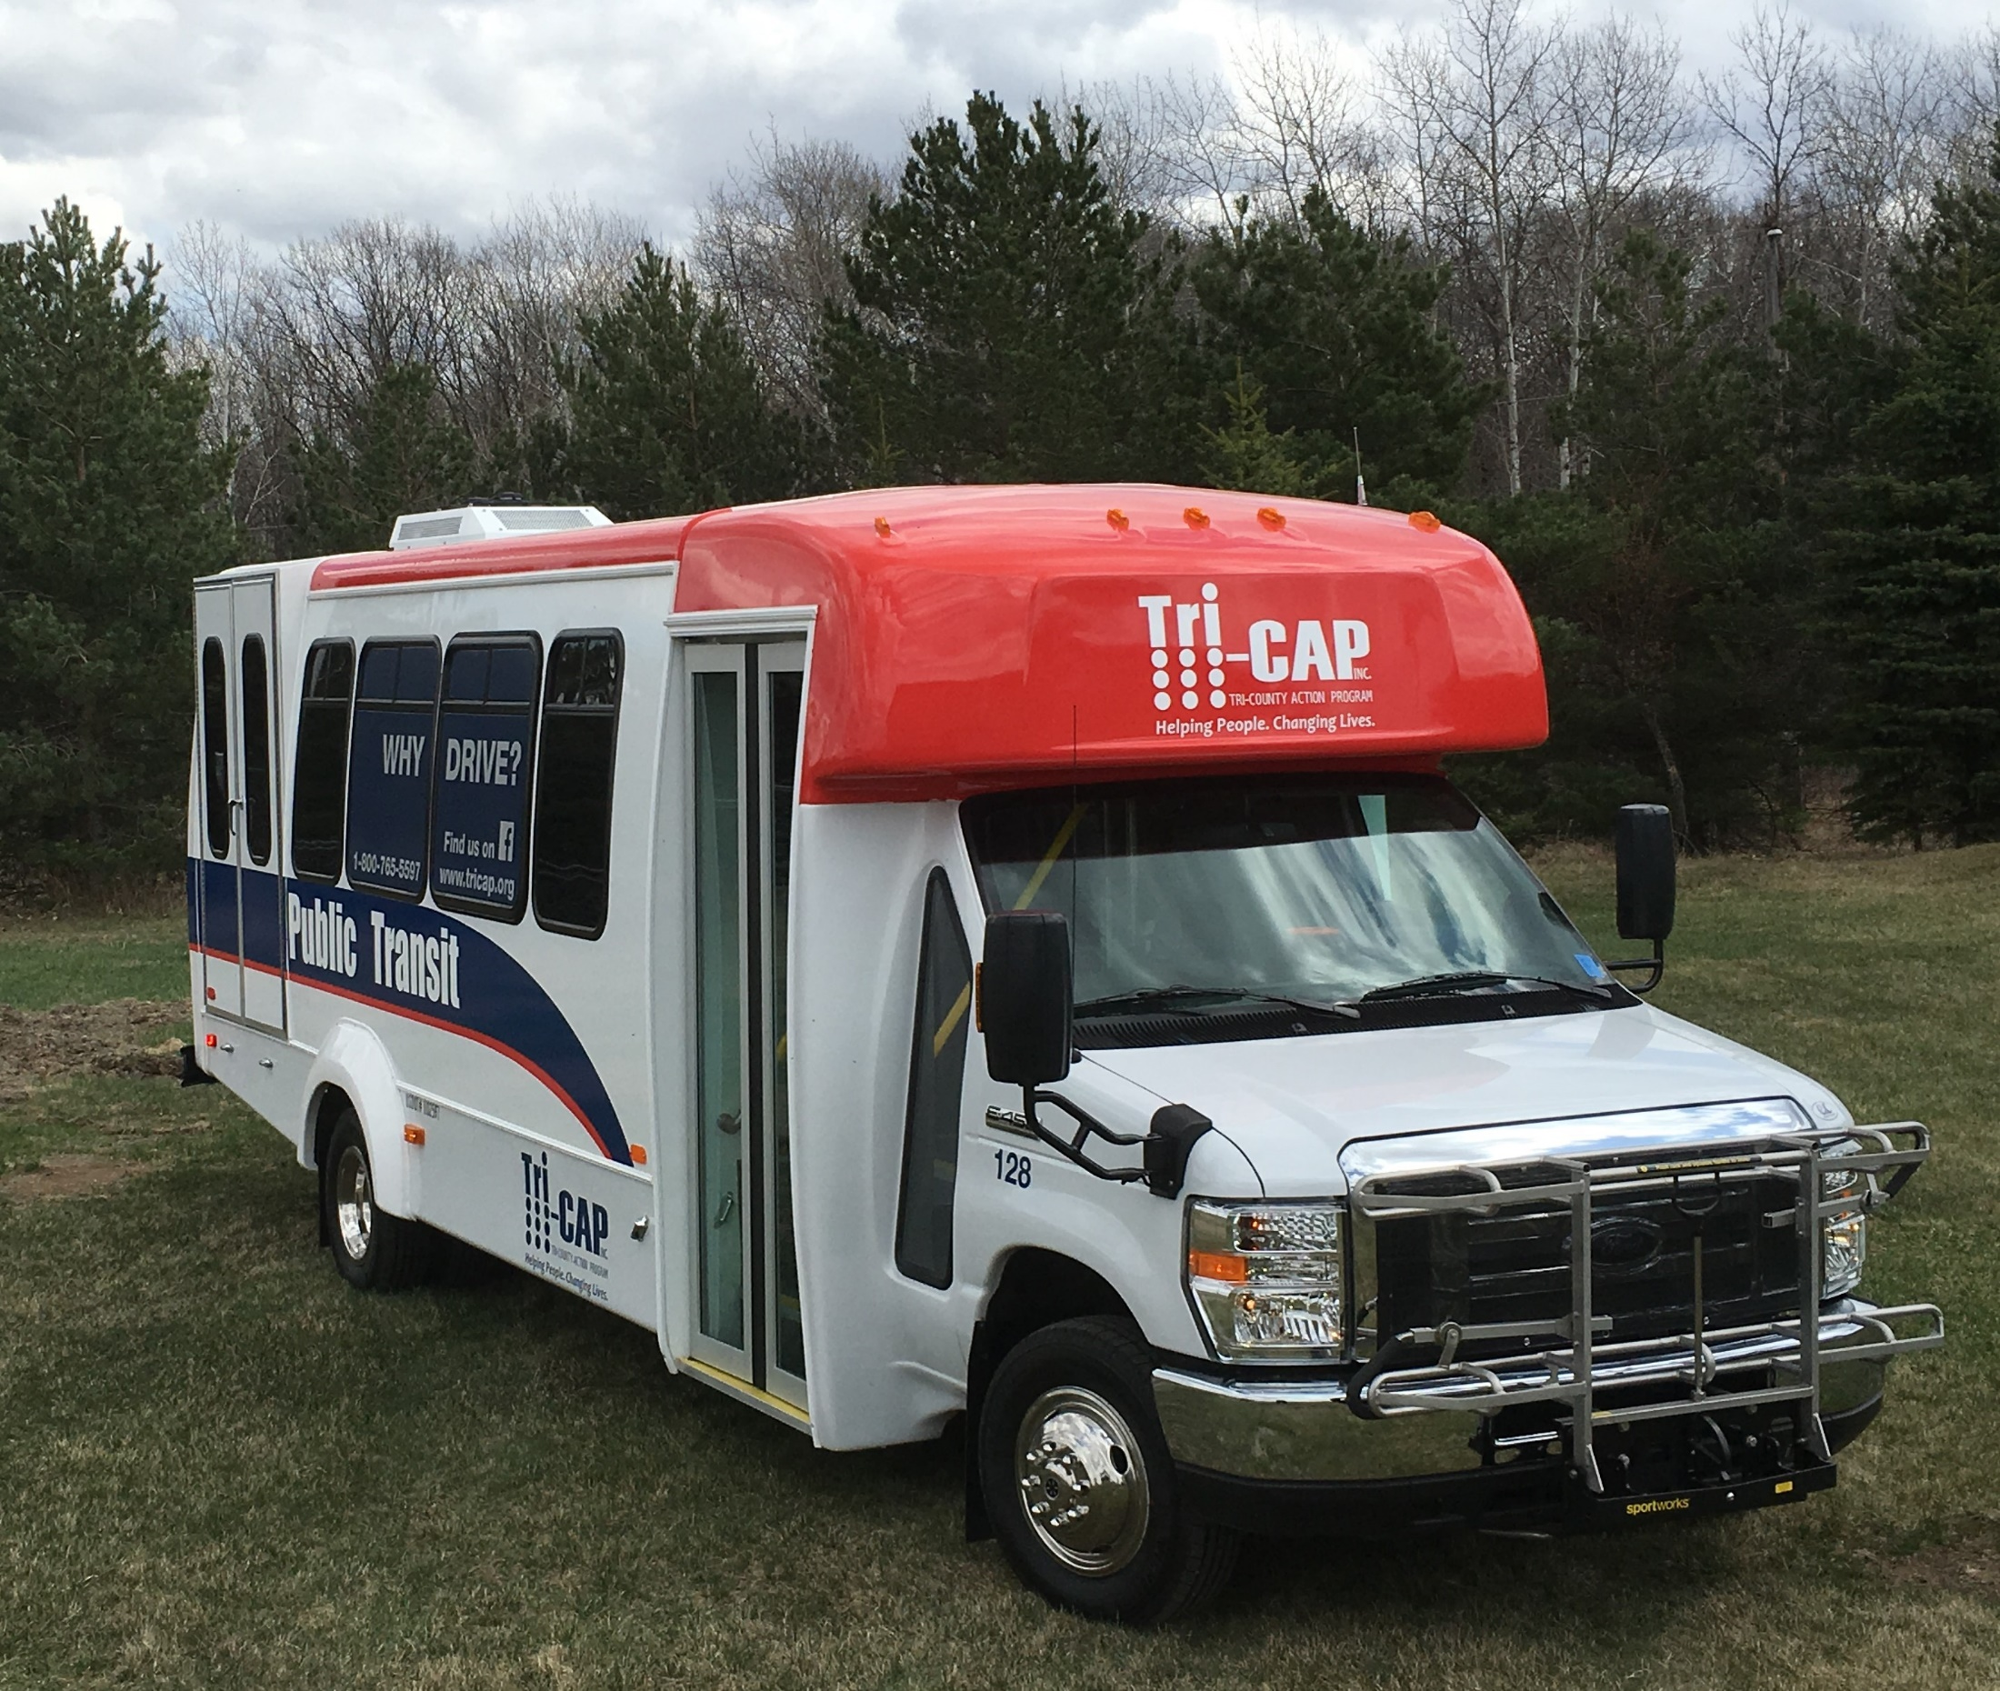

Transit Planning
October 10, 2019

Slide 2
Why Is Planning Important?
Manage Growth/Be Prepared
Have a bigger impact by coordinating with other services/facilities
A collectively held plan develops relationships
A broader territorial view improves economies of scale
Anticipating issues is more cost-effective than reacting to them
Take Time to Think!

Slide 3
Commitment to Meeting People’s Transit Needs
Transit service is a lifeline for people!
We need to expand service to make transit convenient and accessible for more of the people who need it and are requesting service.

Slide 4
Looking at Transportation Whollistically
FTA: Transportation planning is a cooperative process designed to foster involvement by all users of the system, such as businesses, community groups, environmental organizations, the traveling public, freight operators, and the general public, through a proactive public participation process.

Slide 5
Requirements
Federal and State governments recognize the value of long-term planning
Many areas have goals for ridership and service levels – plans make it more likely that these goals will be reached
Different requirements for urban and rural systems but planning is important for everyone

Slide 6
RDCs and MPOs
9 Regional Development Commissions in MN that assist local governments and work on comprehensive planning including transportation planning.
8 Metropolitan Planning Organizations - lead responsibility for a metropolitan area's transportation plans. All urban areas over 50,000 in population are required to have an MPO if the agencies spend Federal funds on transportation improvements.

Slide 7
Making Transit Part of the Plan
Transit plans can and should be incorporated into larger transportation plans and economic development plans.
New businesses and new facilities generate the need for more people to move around the community. Transit needs to be part of the planning for these new developments.
Proactive planning can make transit more visible – not an afterthought.

Slide 8
Metropolitan Council – MPO for Twin Cities Metro
2040 Transportation Policy Plan governs the development of the transportation system – highways, transit, airports, freight facilities
Federal law requires that the Council update the TPP every five years. The plan must be “Fiscally Constrained”
Implement increased transit service and an expanded transitway system; support higher demand for development (housing, shops, jobs) along transit lines and around stations

Slide 9
Metropolitan Council – MPO for Twin Cities Metro
The Current Revenue Scenario assumes that transportation funds will be available based on current laws and experience. The Current Revenue Scenario assumes revenue growth consistent with past growth rates and experience with revenue sources.
The Increased Revenue Scenario represents how the region could invest if funds were available beyond past growth rates implemented through policy and statutory changes at the local, state, or federal levels.

Slide 10
Assessing the Real Need/Telling the Story
Systems receiving 5307 funds develop 5-year plans that are fiscally restrained
Systems that receive 5311 funds have been working on new 5-year plans to help assess community needs and work with local partners to develop the resources to implement new service.

Slide 11
Why 5-Year Plans?
Uncertainty About the Future
  Mergers, RTCCs, Performance Measures, one-year contracts
Difficult to Assess Unmet Needs
  Not worth bothering to ask, don’t have time to deal with it, no local match

Slide 12
Challenges
Lack of Adequate Staffing/Resources
  Can’t devote time to planning, to marketing campaigns, can’t meet future needs without additional staff and assistance through technology.

Slide 13
How to Address these Challenges?
Individual, Tailored 5-Year Plans created by the systems that include a constrained and unconstrained vision including a marketing component with assistance from professional consultants

Slide 14
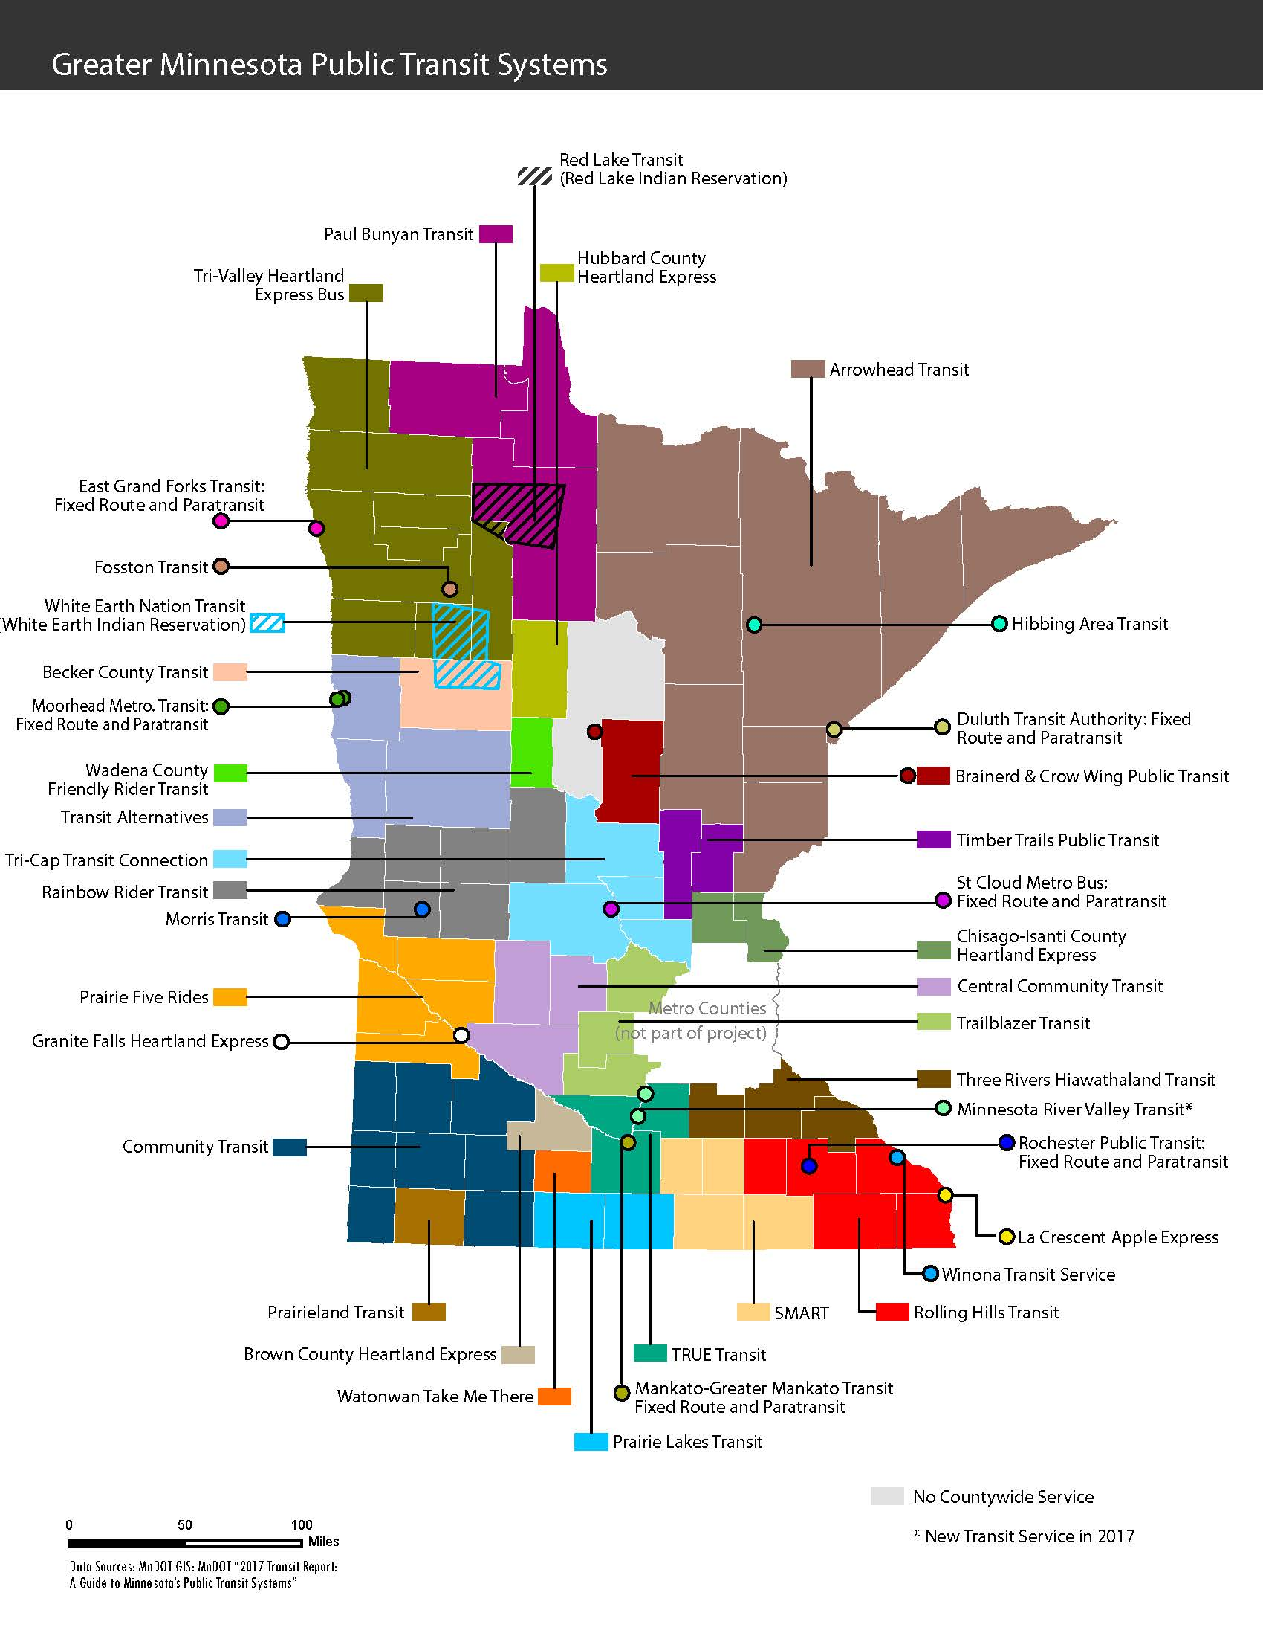

Slide 15

Regions, Transit Providers & Consultants
LSC
PM -
A.T. Stoddard
AECOM
PM -
Jill Cahoon
WSB
PM –
Lee Nichols
AECOM
PM -
Jill Cahoon
SRF
PM -
Joseph Kapper

Slide 16
Completed Plans Will Tell Your Story!
Your system assets and current routes
Your financial situation
Your immediate needs
Your longer-term needs
Your benefit to the community
Allow multi-year contracts
How you fit into the larger planning picture

Slide 17
Completed Plans Will Tell The Transit Story
With well-documented plans from all systems, transit professionals and advocates can explain the statewide funding picture and the cumulative need to policy makers, the news media and the general public.

Slide 18
Maintaining the Plans Will Be Important!
With all the work that goes into Transit Plans, it’s important to keep them updated.
You should receive Excel Templates for:
    Operating Budget – Constrained and Unconstrained
    Capital Budget – Constrained and Unconstrained
    Word files with the full plan that can be edited

Slide 19
Using The Data
For MPTA, we will be compiling all of the information for:
  Reaching out to local partners and news media with the results
  Developing System Profiles to use with legislators and others

Slide 20
Using The Data
For MPTA, we will be compiling all of the information for:
  Advocating for resources: Marketing plans, other assistance
  Providing information to larger Transportation Coalition partners

Slide 21
Thank You for Your Commitment!

