Slide 1
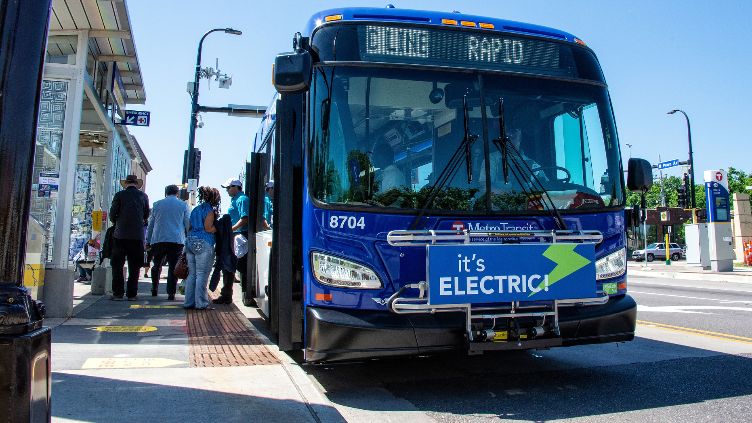
Battery Electric Bus Deployment
Carrie Desmond

Slide 2
Battery Electric Bus (BEB) Pilot Program
Systematic Measured Approach
  Evaluate BEB in Metro Transit’s Service Environment
  Determine Capital and Operational Financial Impacts
  Conduct a Field Test That Compares BEB vs. Diesel
  Select the Best Available Test Route

Slide 3
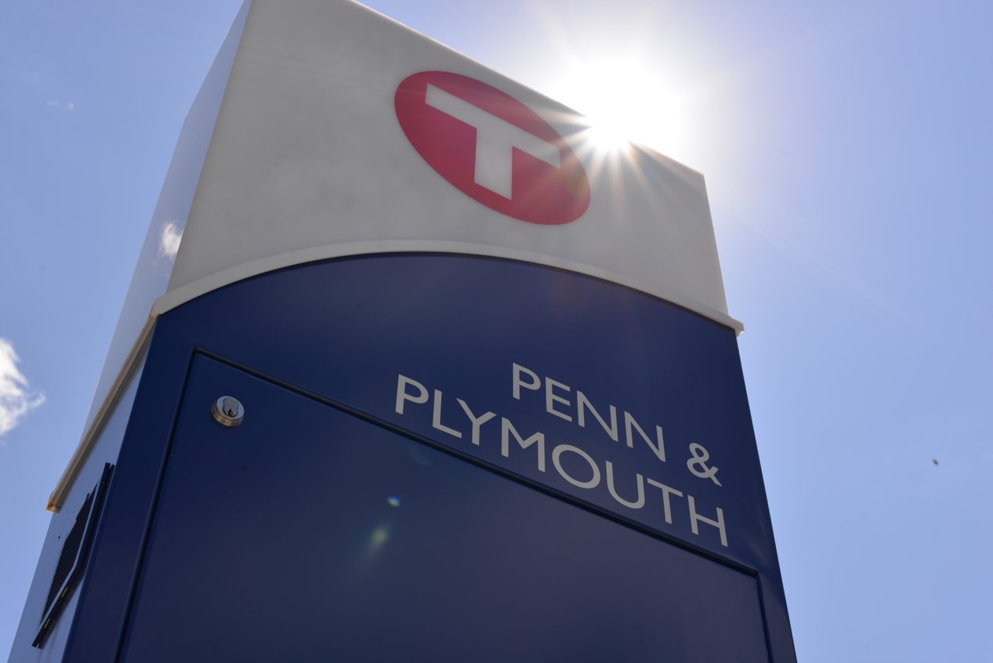
Advantages of BRT Routes
Same Service Envelope
  Traffic conditions
  Stops per mile
  Passenger boarding
  Weather conditions
Training advantages
  Fewer staff to train

Slide 4
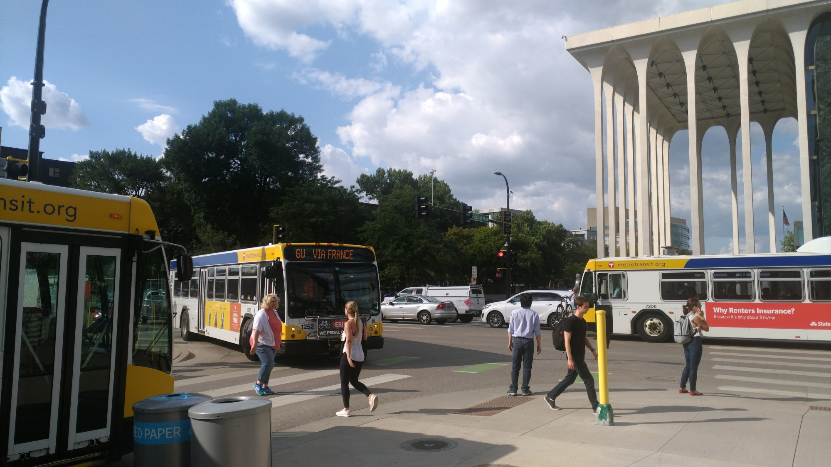
Advantages of Local Routes
More schedule options
  Local service has many more short trips available in the AM/PM
Better bus availability
Route Flexibility
  2 BRT routes vs. 64 local bus routes and 63 express routes

Slide 5
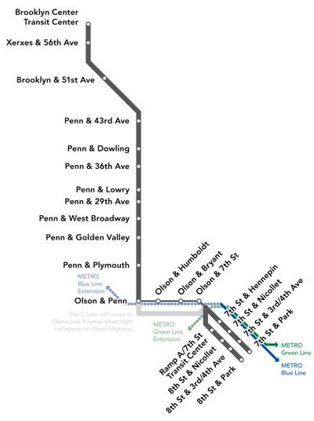
Route Characteristics
17-mile BRT round trip
Daily ridership 7,000 rides
8 Electric and 6 Diesel BRT 60’ Buses
8 Depot chargers at Fred T. Heywood Garage
2 On-route chargers at Brooklyn Center Transit Center

Slide 6
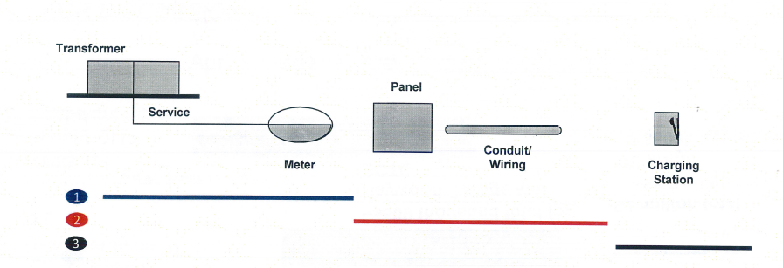
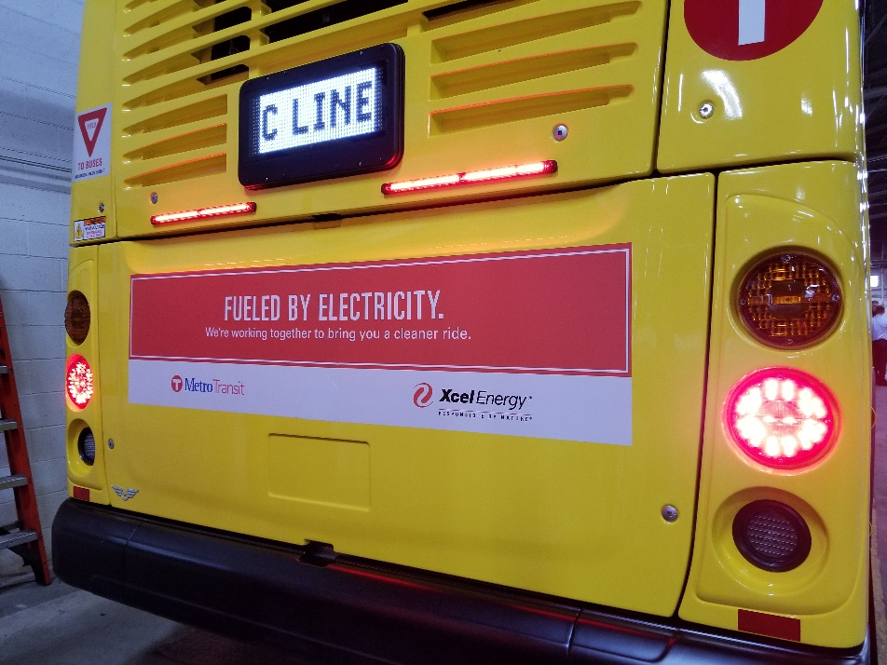
Pilot Project
1 Xcel typically ends at the Transformer/Meter
2 Pilot Project will cover Panel, conduit, and wiring into to base of chargers
3 Metro Transit install charging stations

Slide 7
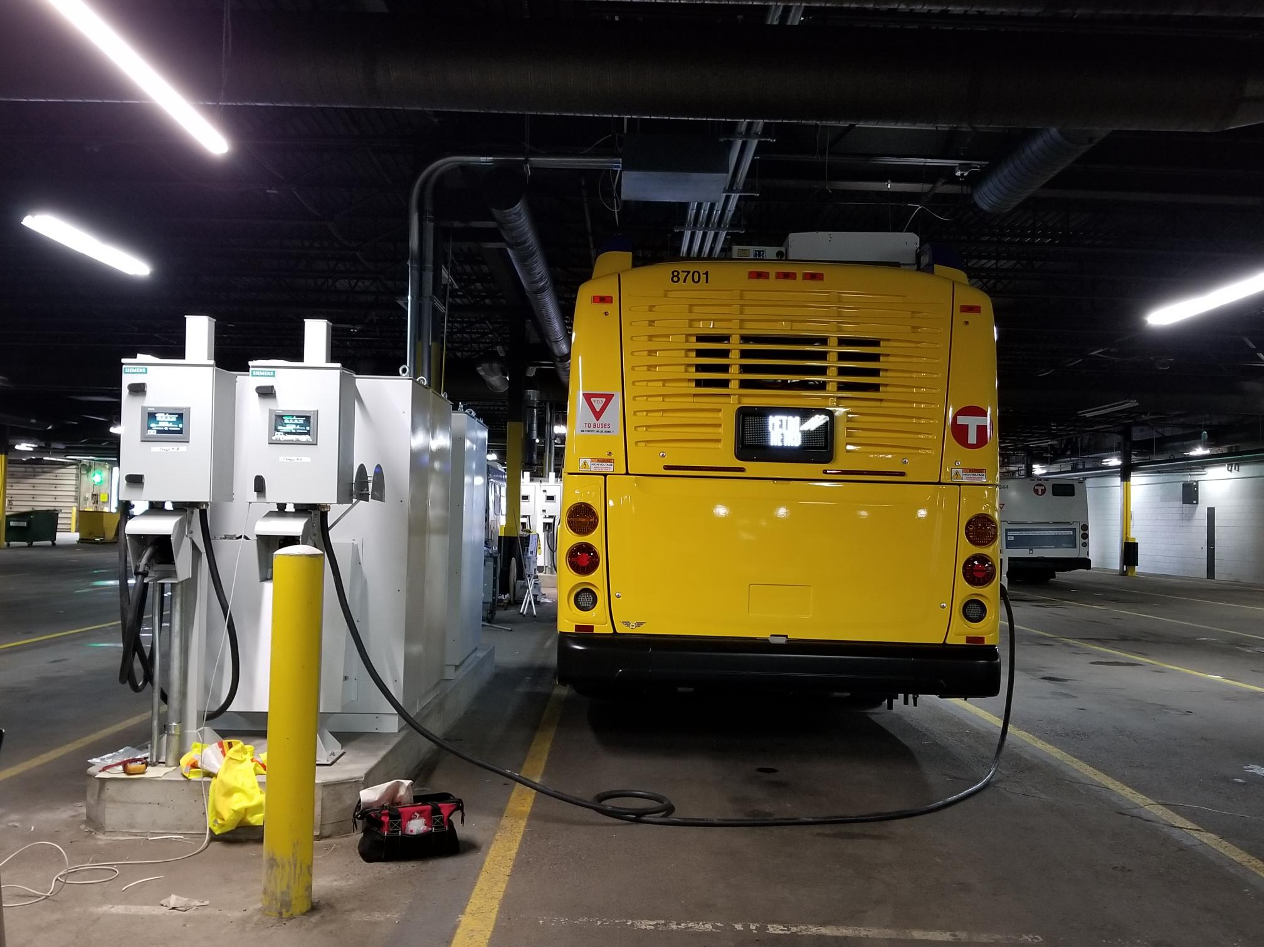
Heywood Garage Infrastructure
Electrical Service by Xcel Energy
Switchgear, conduit, cabling from transformer to chargers by Xcel’s contractor
(8) Siemens RAVE 150 Chargers & Dispensers by Metro Transit contractor
Dispenser
Bus 8701 Charging
Charging Cabinet

Slide 8
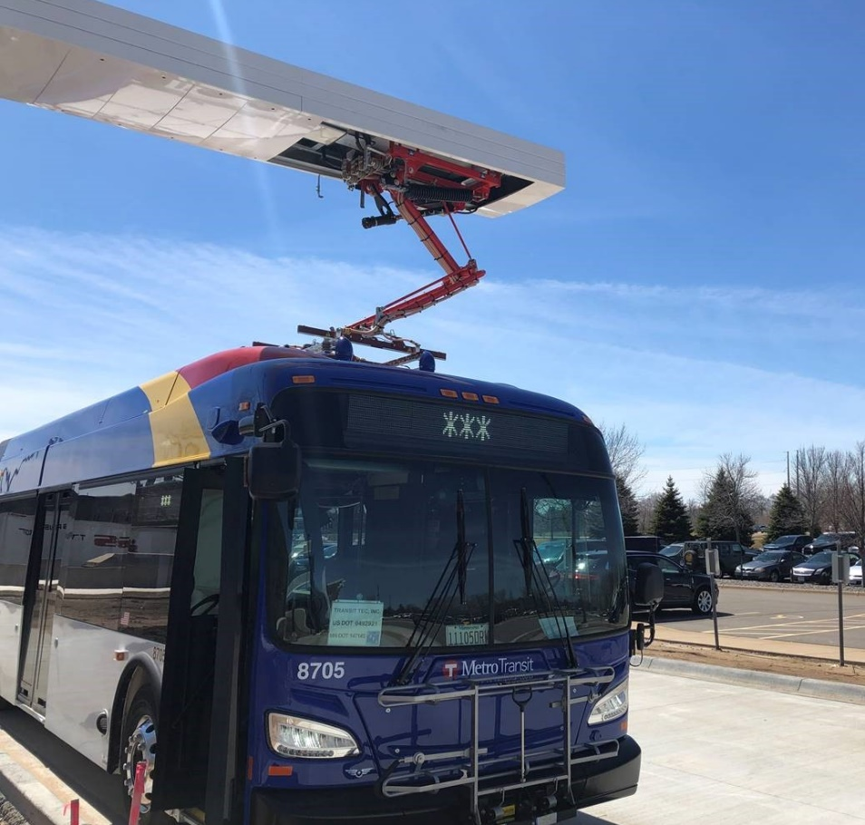
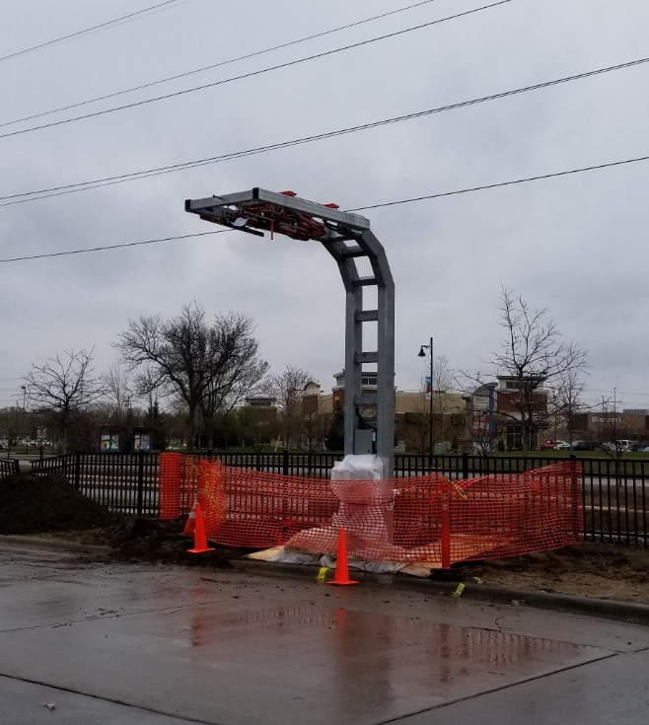
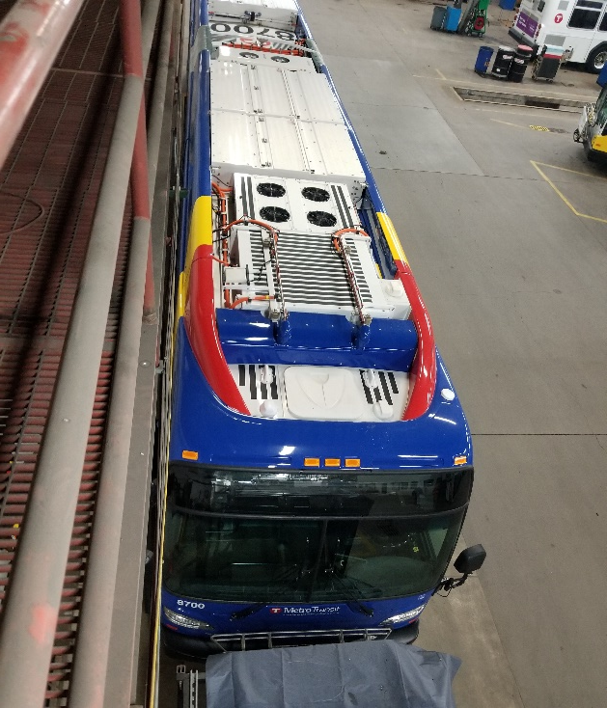
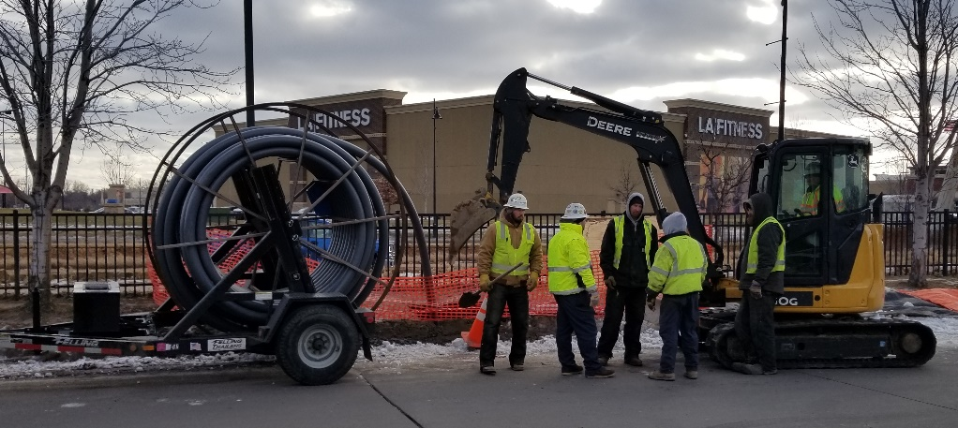
BCTC Infrastructure
Electrical Service by Xcel Energy
Switchgear, conduit, cabling from transformer to chargers by Xcel’s contractor
2 Siemens 300kW on-route chargers by Metro Transit contractor
Notes:
Existing soil conditions and elevation of the site have lead to the design layout. While the site is located next to a core service area, the site is on top of the infill area of Bassett Creek, thus there are a lot of soft organic soils that require a pile driven foundation system similar to a lot other developments in the area.
The original concept design in 2011 had a bus slab on grade and structured roof for staff parking, but once it was determined that a bus slab on grade could settle up to 6” over the first 20 years and a structured slab was needed, the design flipped the staff parking to the existing grade and moved the structured slab into the air as it doesn’t matter if that structured slab is on the ground or 15’ in the air.
The site elevation across the site, it raises 12’ from 10th Ave to 11th Ave, allowed the bus access point at a similar elevation of 11th Avenue, thus the 2nd level or main level of the facility better lines up with the access point off 11th Avenue N.
At the beginning of the design, a sustainability workshop that focused on the overall work place environment to keep in mind not only energy efficiency, but Health, resilience, happiness, beauty, water and land balance of the project and staff. The staff that use the facility ranked how important 12 different goals to help guide the design process so we ensure that the building supports staff in their daily work. Health (of employees), Resilience (minimize downtime for ops), Visionary (anticipate future needs/adaptability) were the top 3.
Some other specific items included the project that support
Garage is future planning additional electrical infrastructure for more electric buses
Instead of a metal panel wall, the design has a metal panel system that is used to pre-heat fresh air coming into the heating system that is projected to reduce the heating load 10%
A system of pipes and tanks will collect, store, and treat rain water to be used in the first cycle of the bus wash, reducing potable water consumptions of the bus wash by 34%
The average EUI of our buildings is around 80 kbtu/sf/yr

Slide 9
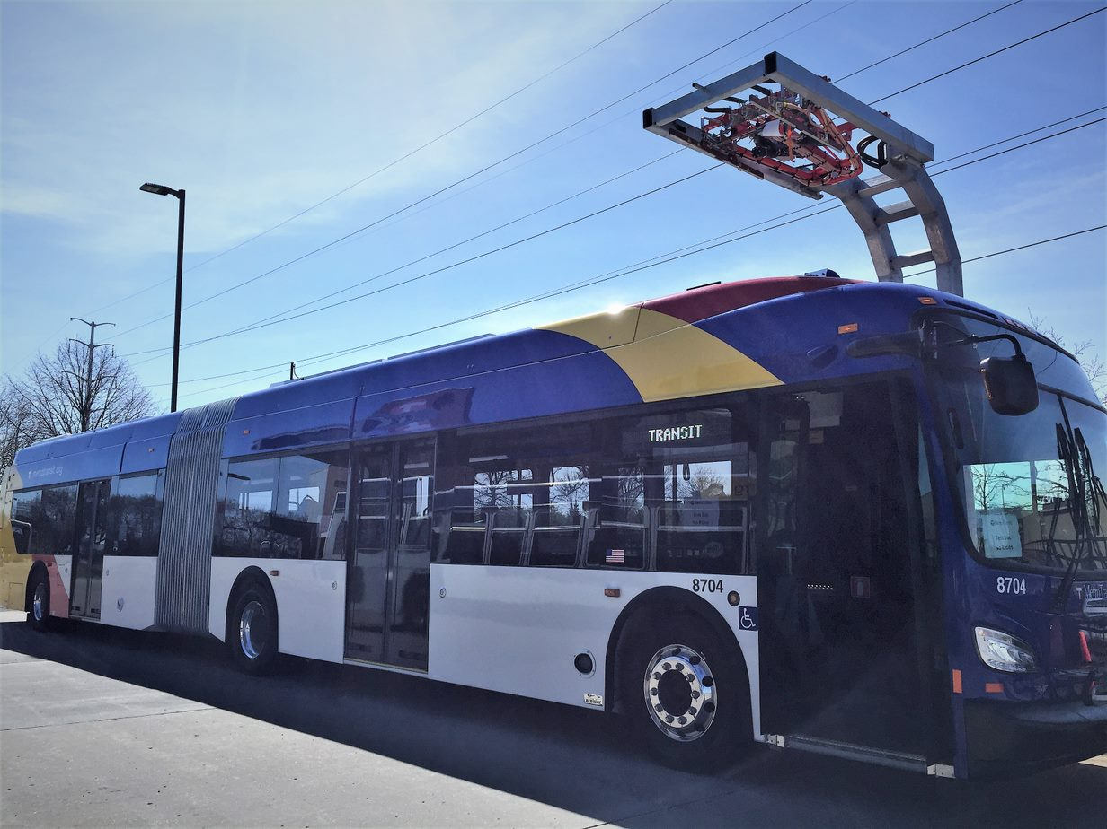
Today’s experience
Challenges
  Bus charger delays
  Unclear safety requirements
  Vendor support readiness
  Capturing accurate energy usage
Successes
  Electric buses in service every day
  Well received both internally and externally
  Bus efficiency is meeting expectation

Slide 10
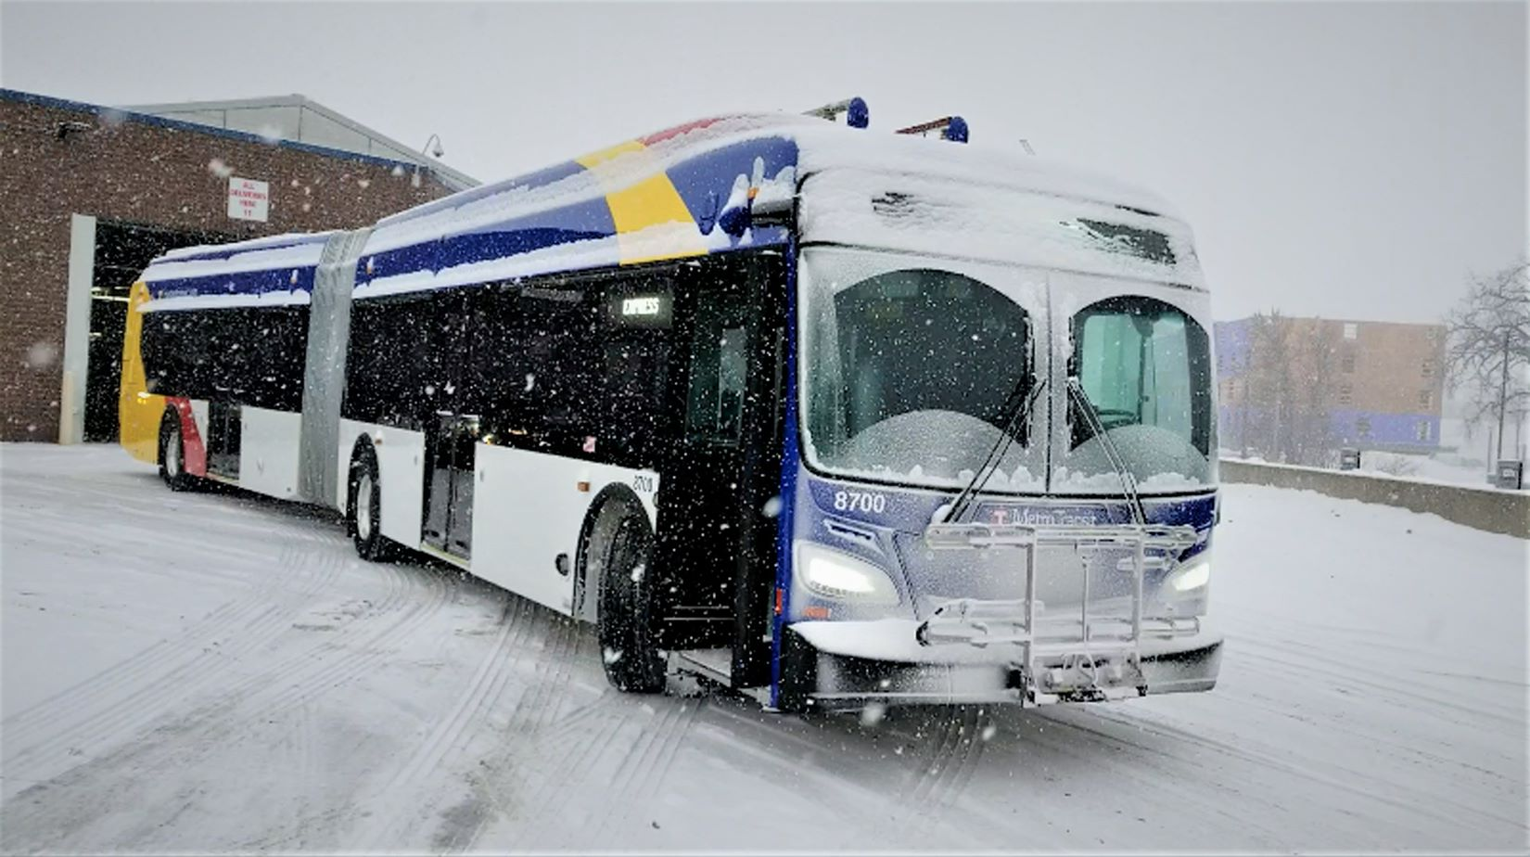
In Conclusion

