Slide 1
Measuring the Economic Benefits of Transit in Greater Minnesota
Minnesota Public Transit Conference
October 11, 2019
St. Paul, MN
Jeremy Mattson, PhD
Small Urban and Rural Transit Center
Upper Great Plains Transportation Institute
North Dakota State University

Slide 2
Acknowledgements
This project is funded by MnDOT. MnDOT transit planners proposed this project and was selected for funding through Research Services competitive process. The Technical Advisory Panel includes transit providers and stakeholders from Greater Minnesota.

Slide 3
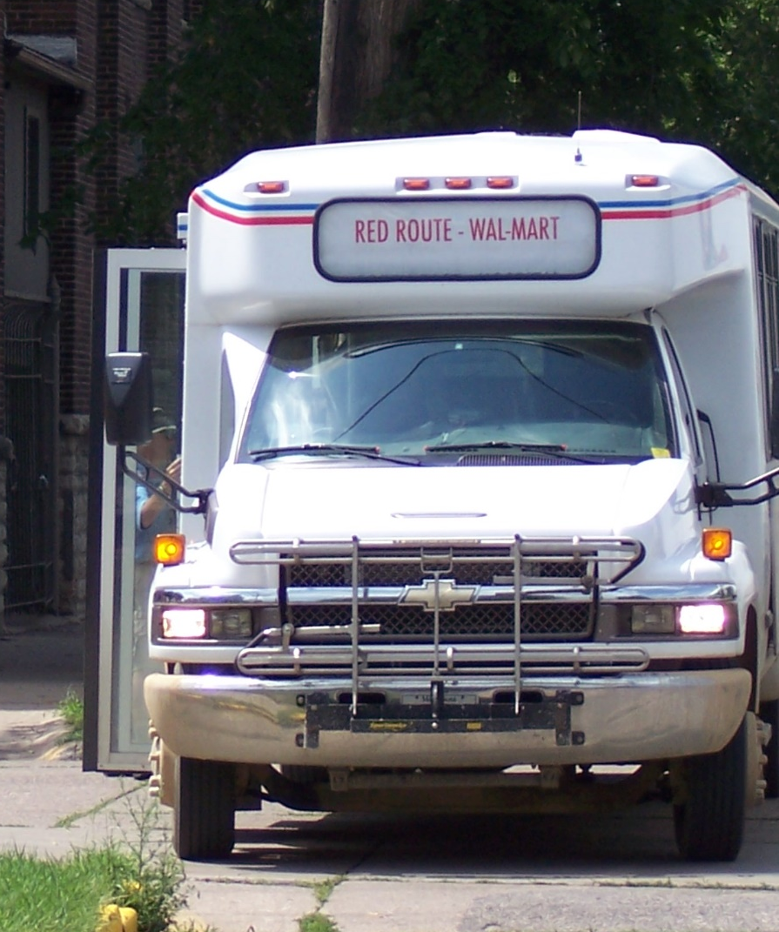
Research Problem
Benefits of rural transit largely unmeasured or unidentified
Scarce resources for funding rural transit
Information is needed to support investment decisions

Slide 4
Study Approach
Identify the benefits we want to measure
Categorize benefits
Types of benefits
Who benefits
Create transit benefits assessment tree
Develop method for measuring benefits
Develop tool

Slide 5
Minnesota Stakeholder Survey: Perceived Benefits of Transit
Notes:
One of the first things we did was to survey stakeholders across the state to get their opinions about what they believe the benefits are of transit services in Greater Minnesota.
Stakeholders included human service agencies, cities and counties, public health departments, community organizations, health care providers, schools, transportation providers, private companies, local elected officials, non-profits, and others. There were over 400 responses from across Greater Minnesota.

Slide 6
Societal Benefits
Mobility Benefits
Efficiency Benefits
Economic Impacts
Direct User Benefits
Public Cost Savings
Productivity
Transit Benefits
Impacts from Transit Spending
Impacts from Improved Access to Shopping
Impacts from Increased Population in Community
Health Benefits
Relocation Cost Savings
Equity
Option Value
Vehicle Cost Savings
Chauffeuring Cost Savings
Safety Benefits
Environmental Benefits
Travel Time Impacts
Reduced Congestion
Low-cost Mobility Benefits
Intangible Benefits
Social Connectedness
Independent Living
Work Trips
Education Trips
Shopping Trips
Recreation Trips
Other Trips
Health Care Cost Savings
Quality of Life Improvement
Health Benefits
Transit Benefits Assessment Tree

Slide 7
Transit Benefits Assessment Tree
Transit Benefits
Societal Benefits
Economic Impacts
Mobility Benefits
Efficiency Benefits
Notes:
Two main types of benefits are societal benefits and economic impacts. Economic impacts are not strictly net benefits and are estimated using an economic impact analysis. These impacts should be reported separately and not added to the societal benefits.
Societal benefits include mobility benefits and efficiency benefits. If transit service were not available, transit users would either make the trip in some other way or forgo the trip. Mobility benefits are the benefits of providing trips that otherwise would have been forgone, and efficiency benefits are the benefits from making trips with transit instead of the automobile or some other mode.

Slide 8
Transit Benefits Assessment Tree
Mobility Benefits
Direct User Benefits
Public Cost Savings
Productivity
Equity
Option Value
Notes:
Mobility benefits include direct user benefits, public cost savings, productivity gains, equity, and the option value.
Direct user benefits are benefits to transit users for making trips that they otherwise would not have made.
Transit may be able to reduce government spending in other areas. For example, by providing transportation to work for people who otherwise would not be able to travel to work, transit could reduce unemployment and decrease the need for public assistance spending.
Productivity could increase by providing increased access to jobs and education. Transit benefits local businesses by providing transportation to work. This increases the potential labor pool for local businesses and can have positive impacts on their productivity. Transit allows many, including immigrant populations, who struggle with mobility and inclusion to have an impact on the economic viability of rural communities.
Transit promotes equity within a community by giving the opportunity for people of all abilities, incomes, and situations to access work, health care, shopping, recreation, and other services and activities. It increases economic and social opportunities for people who are economically, physically, and socially disadvantaged. More specifically, disadvantaged groups can include low-income households, carless households, youth, older adults, people with disabilities, and racial and ethnic minorities, including immigrants.
Transit provides an option to non-users in case of an emergency. For example, if their car breaks down or is temporarily unavailable, or if they temporarily cannot drive due to health or some other reason, transit provides them an option for making those trips. Although they do not use transit now, future use is uncertain, and there is value to having transit as an option. Transit can also support emergency response services, such as evacuating during an emergency.

Slide 9
Direct User Benefits
Health Benefits
Low-cost Mobility Benefits
Relocation Cost Savings
Intangible Benefits
Health Care Cost Savings
Work Trips
Social Connectedness
Quality of Life Improvement
Education Trips
Independent Living
Shopping Trips
Recreation Trips
Other Trips
Notes:
Direct user benefits are benefits to transit users for making trips that they otherwise would not have made. This includes health benefits from making additional health care trips. If transit users are able to access health care services for routine care or care for chronic conditions, they can better manage their health, which can lead to reduced need for more expensive care later and improved quality of life.
In addition to health care trips, transit riders benefit from taking trips for other purposes that would have been forgone in the absence of transit. Low-cost mobility benefits represent the economic value of providing an affordable transportation mode. They accrue to low-income transit dependent individuals who would forgo the trip if they did not have access to transit.
Some transit users would potentially need to relocate if the service was not available. Without transit, a transportation-disadvantaged individual may not be able to access needed activities, such as health care, work, nutrition, etc., and may need to relocate to somewhere with better access. This could include moving to an assisted living facility or simply moving to a different community with better access. There may be significant costs involved with moving. An assisted living facility can be significantly more expensive than aging in place, and those who move to another community for improved access usually move to a larger city that may have a higher cost of living.
There are other intangible benefits to improving mobility and providing trips that would otherwise be forgone. Transit reduces social isolation and improves social connectedness, especially for older adults and those with disabilities that make travel difficult. Increased participation of people in the community leads to greater levels of interaction and connection. Transit also promotes independent living, which was commonly noted in the stakeholder survey as one of the main benefits of rural transit. Increasing social connections and allowing for independent living can result in significant quality of life benefits and can have implications for mental health.

Slide 10
Efficiency Benefits
Vehicle Cost Savings
Chauffeuring Cost Savings
Safety Benefits
Environmental Benefits
Travel Time Impacts
Reduced Congestion
Health Benefits
Transit Benefits Assessment Tree
Notes:
If the trip is made some other way, such as by people driving themselves, getting a ride from someone, taking a taxi or Uber, walking, or biking, then additional costs would be incurred. Efficiency benefits include the costs avoided by using transit instead of another mode.
Shifting trips to transit also has impacts on travel time, safety, the environment, and congestion, which should also be considered when calculating efficiency benefits. For rural and small urban transit, the most significant benefit within this category would likely be vehicle cost savings or chauffeuring cost savings. There could be health benefits from shifting trips to transit, as well, if it results in increased walking.

Slide 11
Economic Impacts
Impacts from Transit Spending
Impacts from Improved Access to Shopping
Impacts from Increased Population in Community
Transit Benefits Assessment Tree
Notes:
The impacts from transit spending are those that result from the existence of transit operations, including direct effects, indirect effects, and induced economic activity. The direct effect includes the jobs created directly by the transit system – drivers, dispatchers, mechanics, bookkeepers, program directors, etc. The indirect effect results from jobs and income spent in industries that supply inputs to public transit, such as fuel, repairs, insurance, etc. Induced economic activity results from the income generated through both the direct and indirect effects. These induced effects occur when the people who work for the transit system and the people who work for businesses indirectly affected by transit spend their new income in the community. This spending supports additional jobs in the local economy.
Transit impacts the local economy in other ways. Transit improves access to local businesses for those who cannot or do not drive. Without transit, transportation-disadvantaged individuals may purchase more goods online rather than from local stores and make few, if any, trips to restaurants and other local businesses. Therefore, with transit, more spending may occur within the local community. As noted before, if transit is not available, some may decide to relocate to another community. Therefore, transit has the potential to keep people living in the community, and it may even attract some people to move to the community. The people who stay in, or move to, the community spend money within the community, supporting the local economy. If these people left, there could be negative impacts for local businesses.

Slide 12
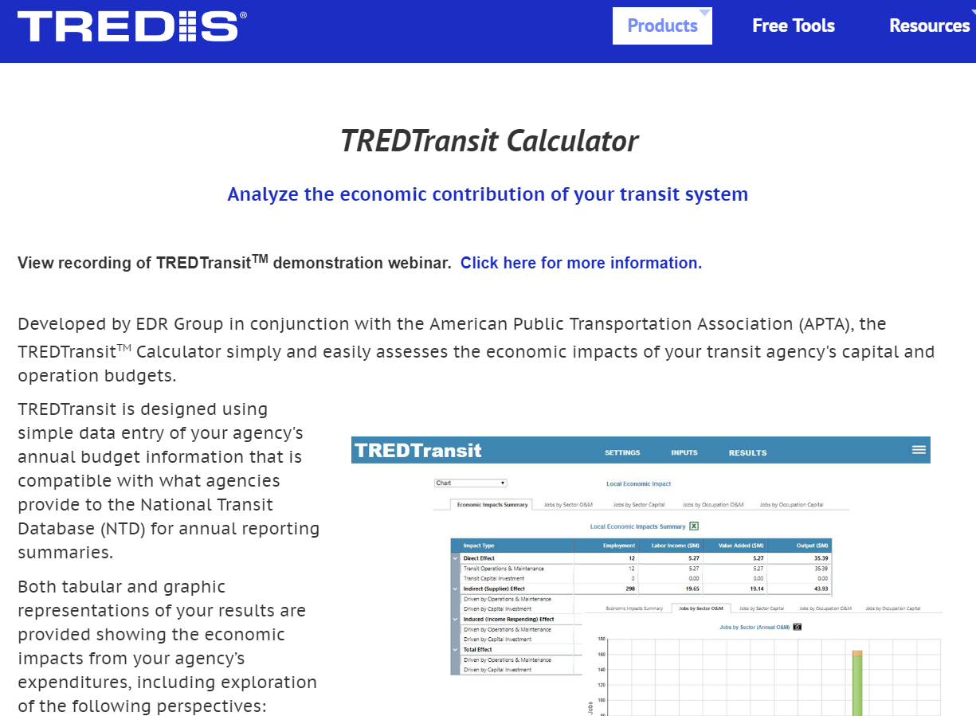
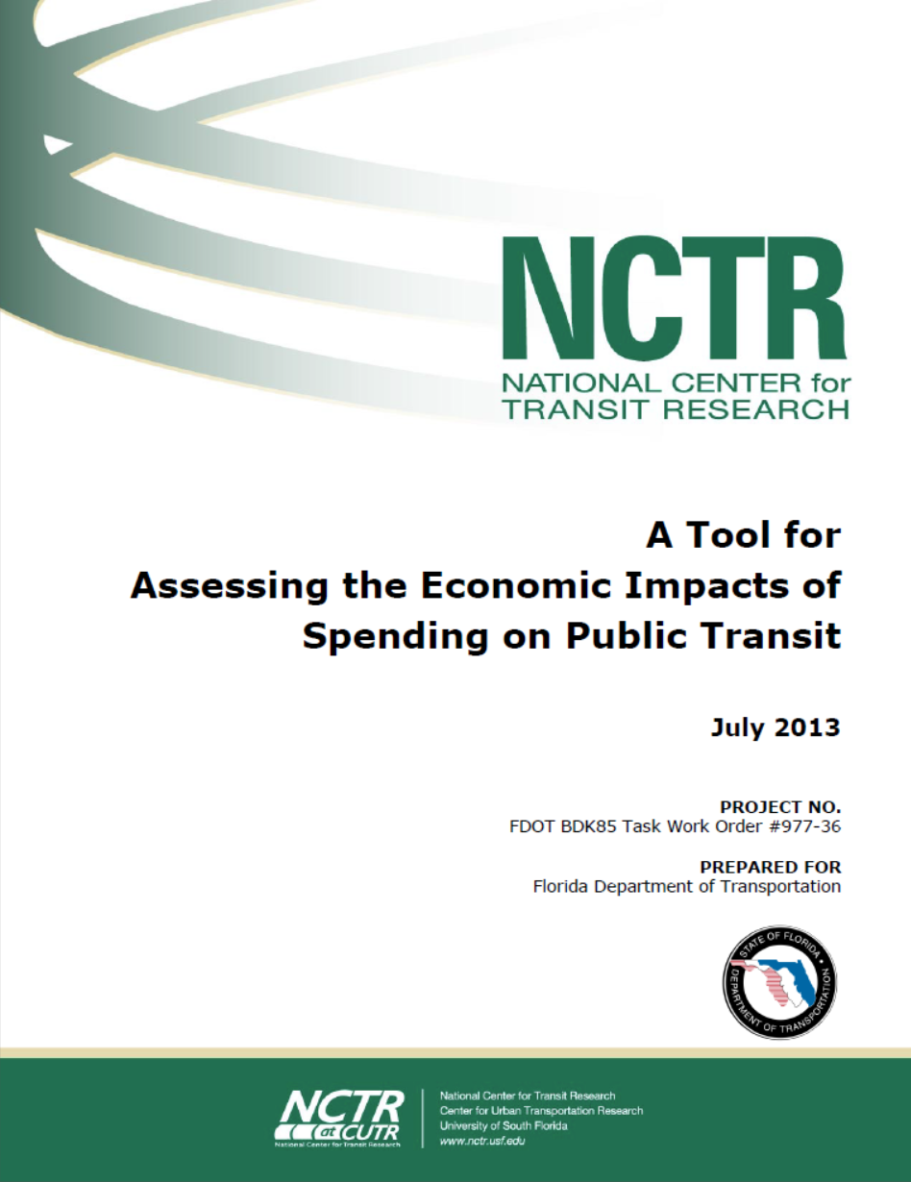
Measuring Benefits – Economic Impacts
Impacts from Transit Spending

Slide 13
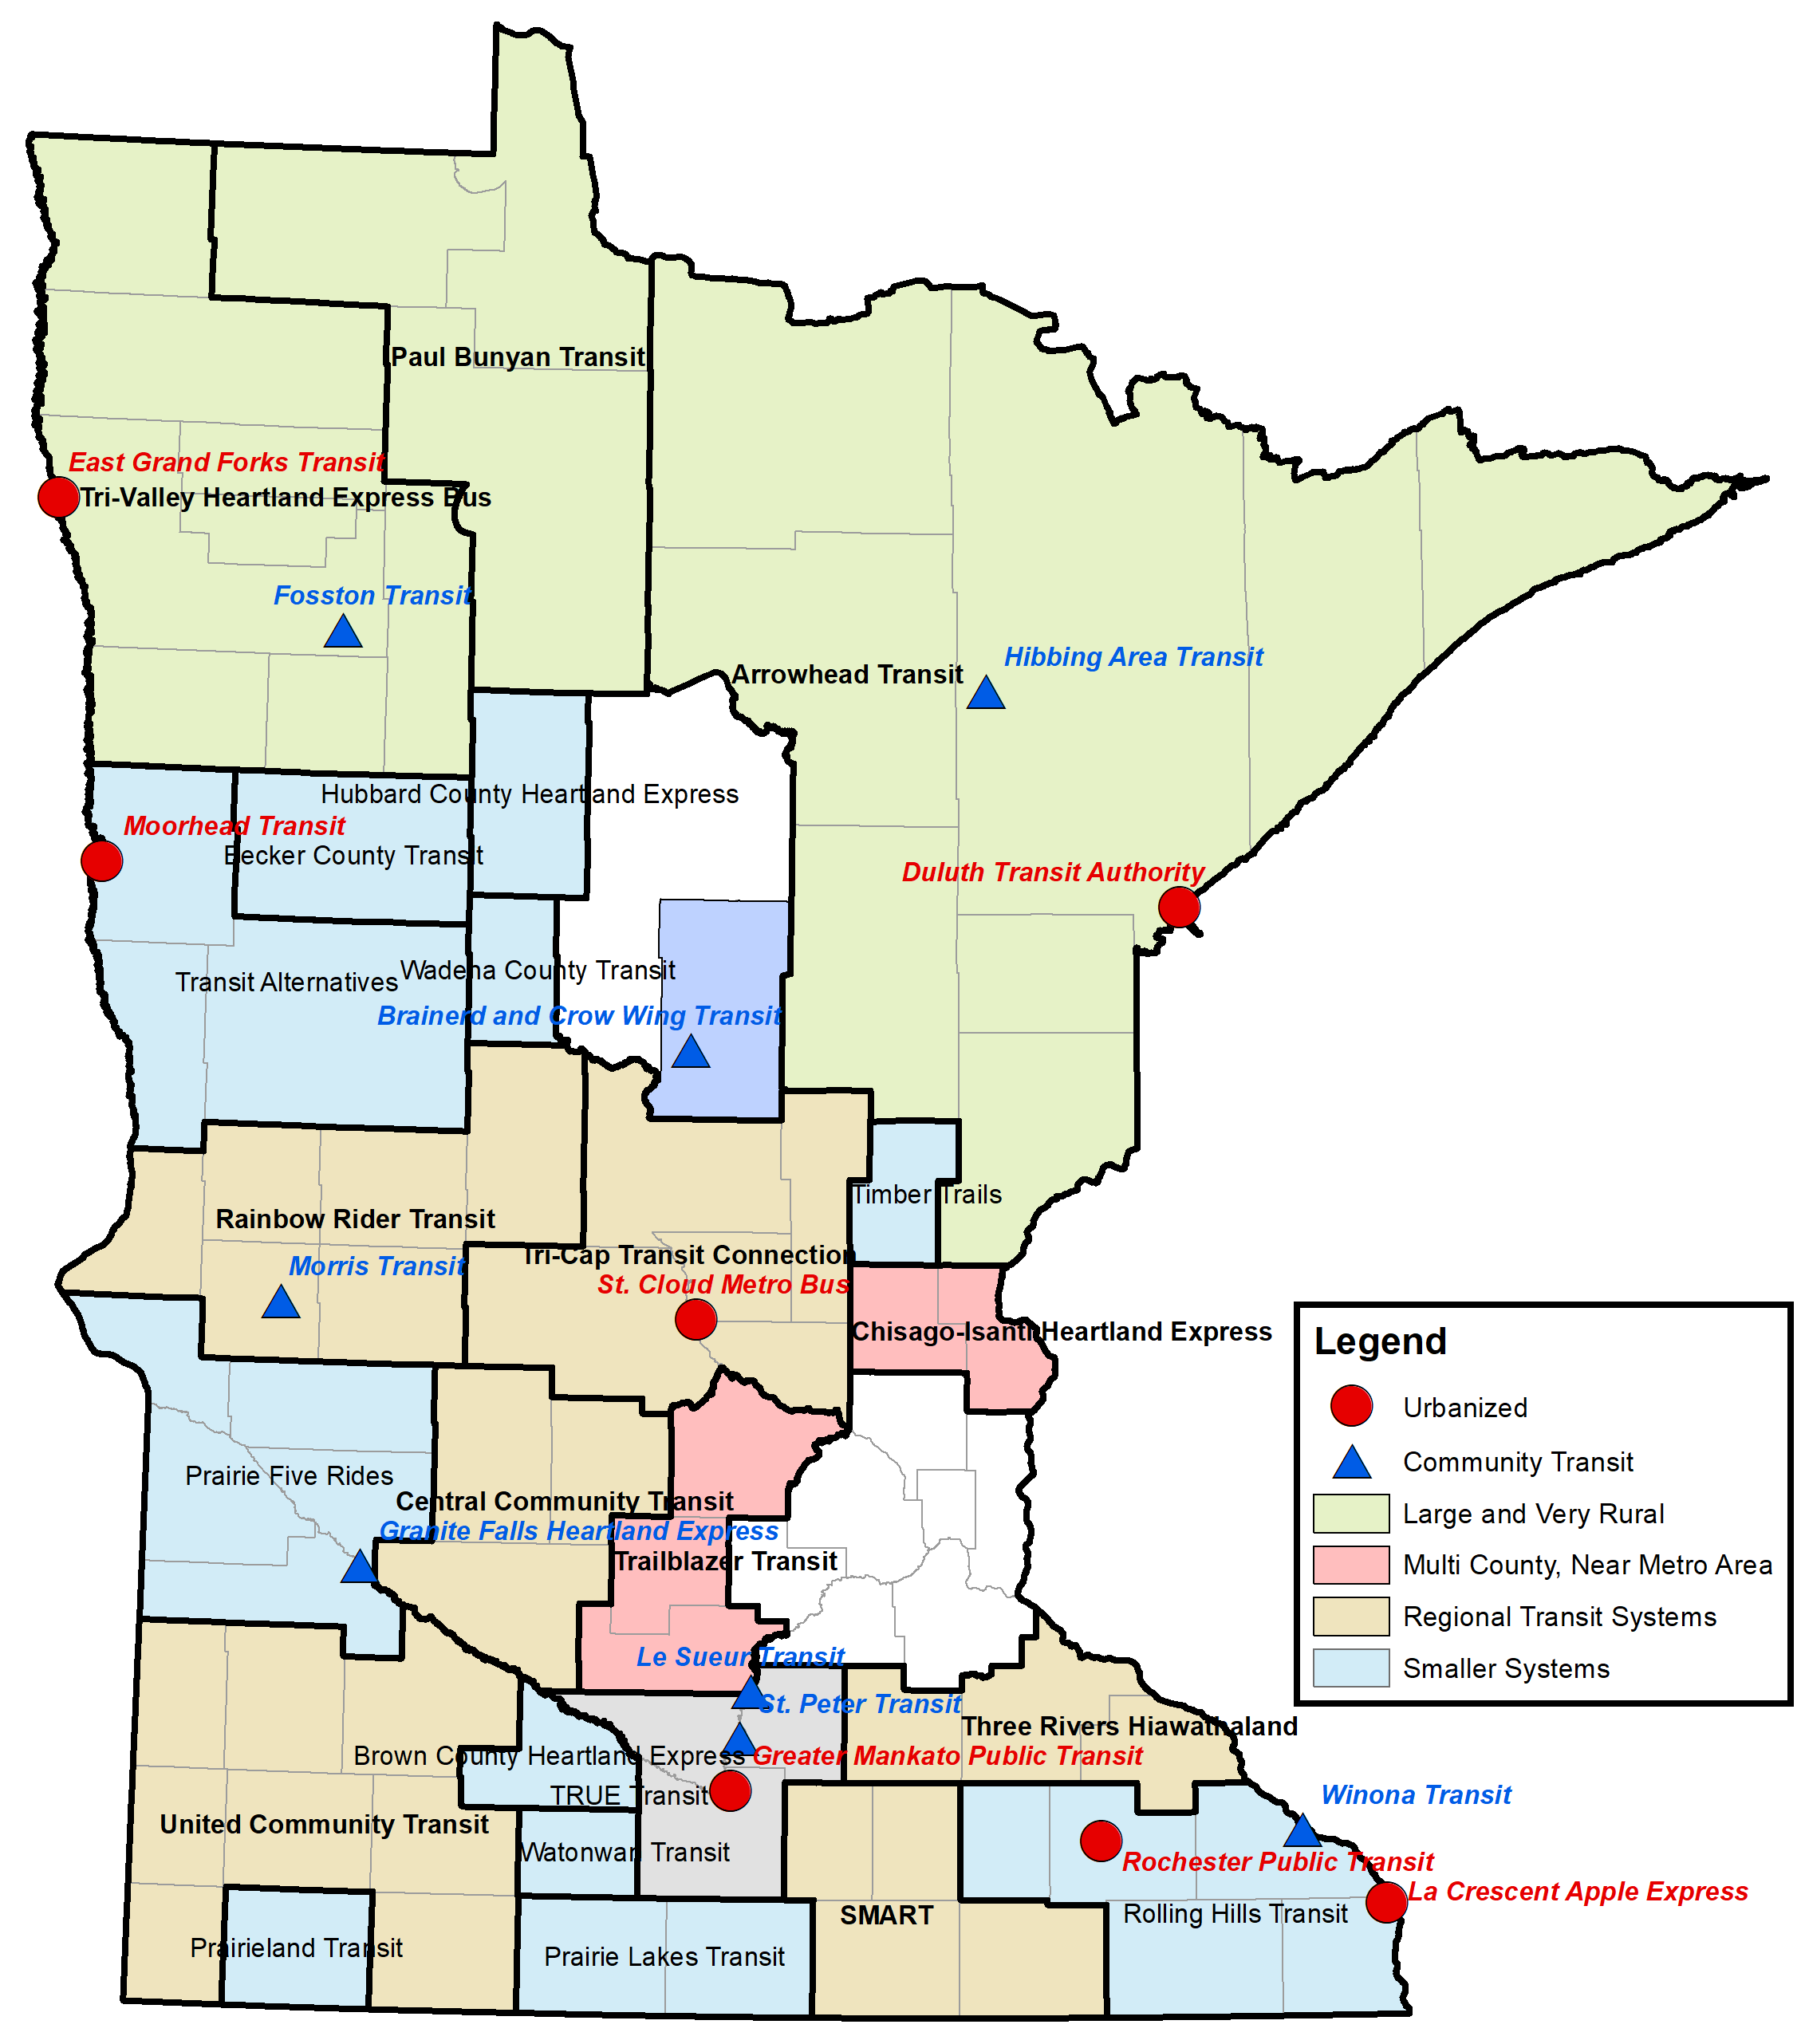
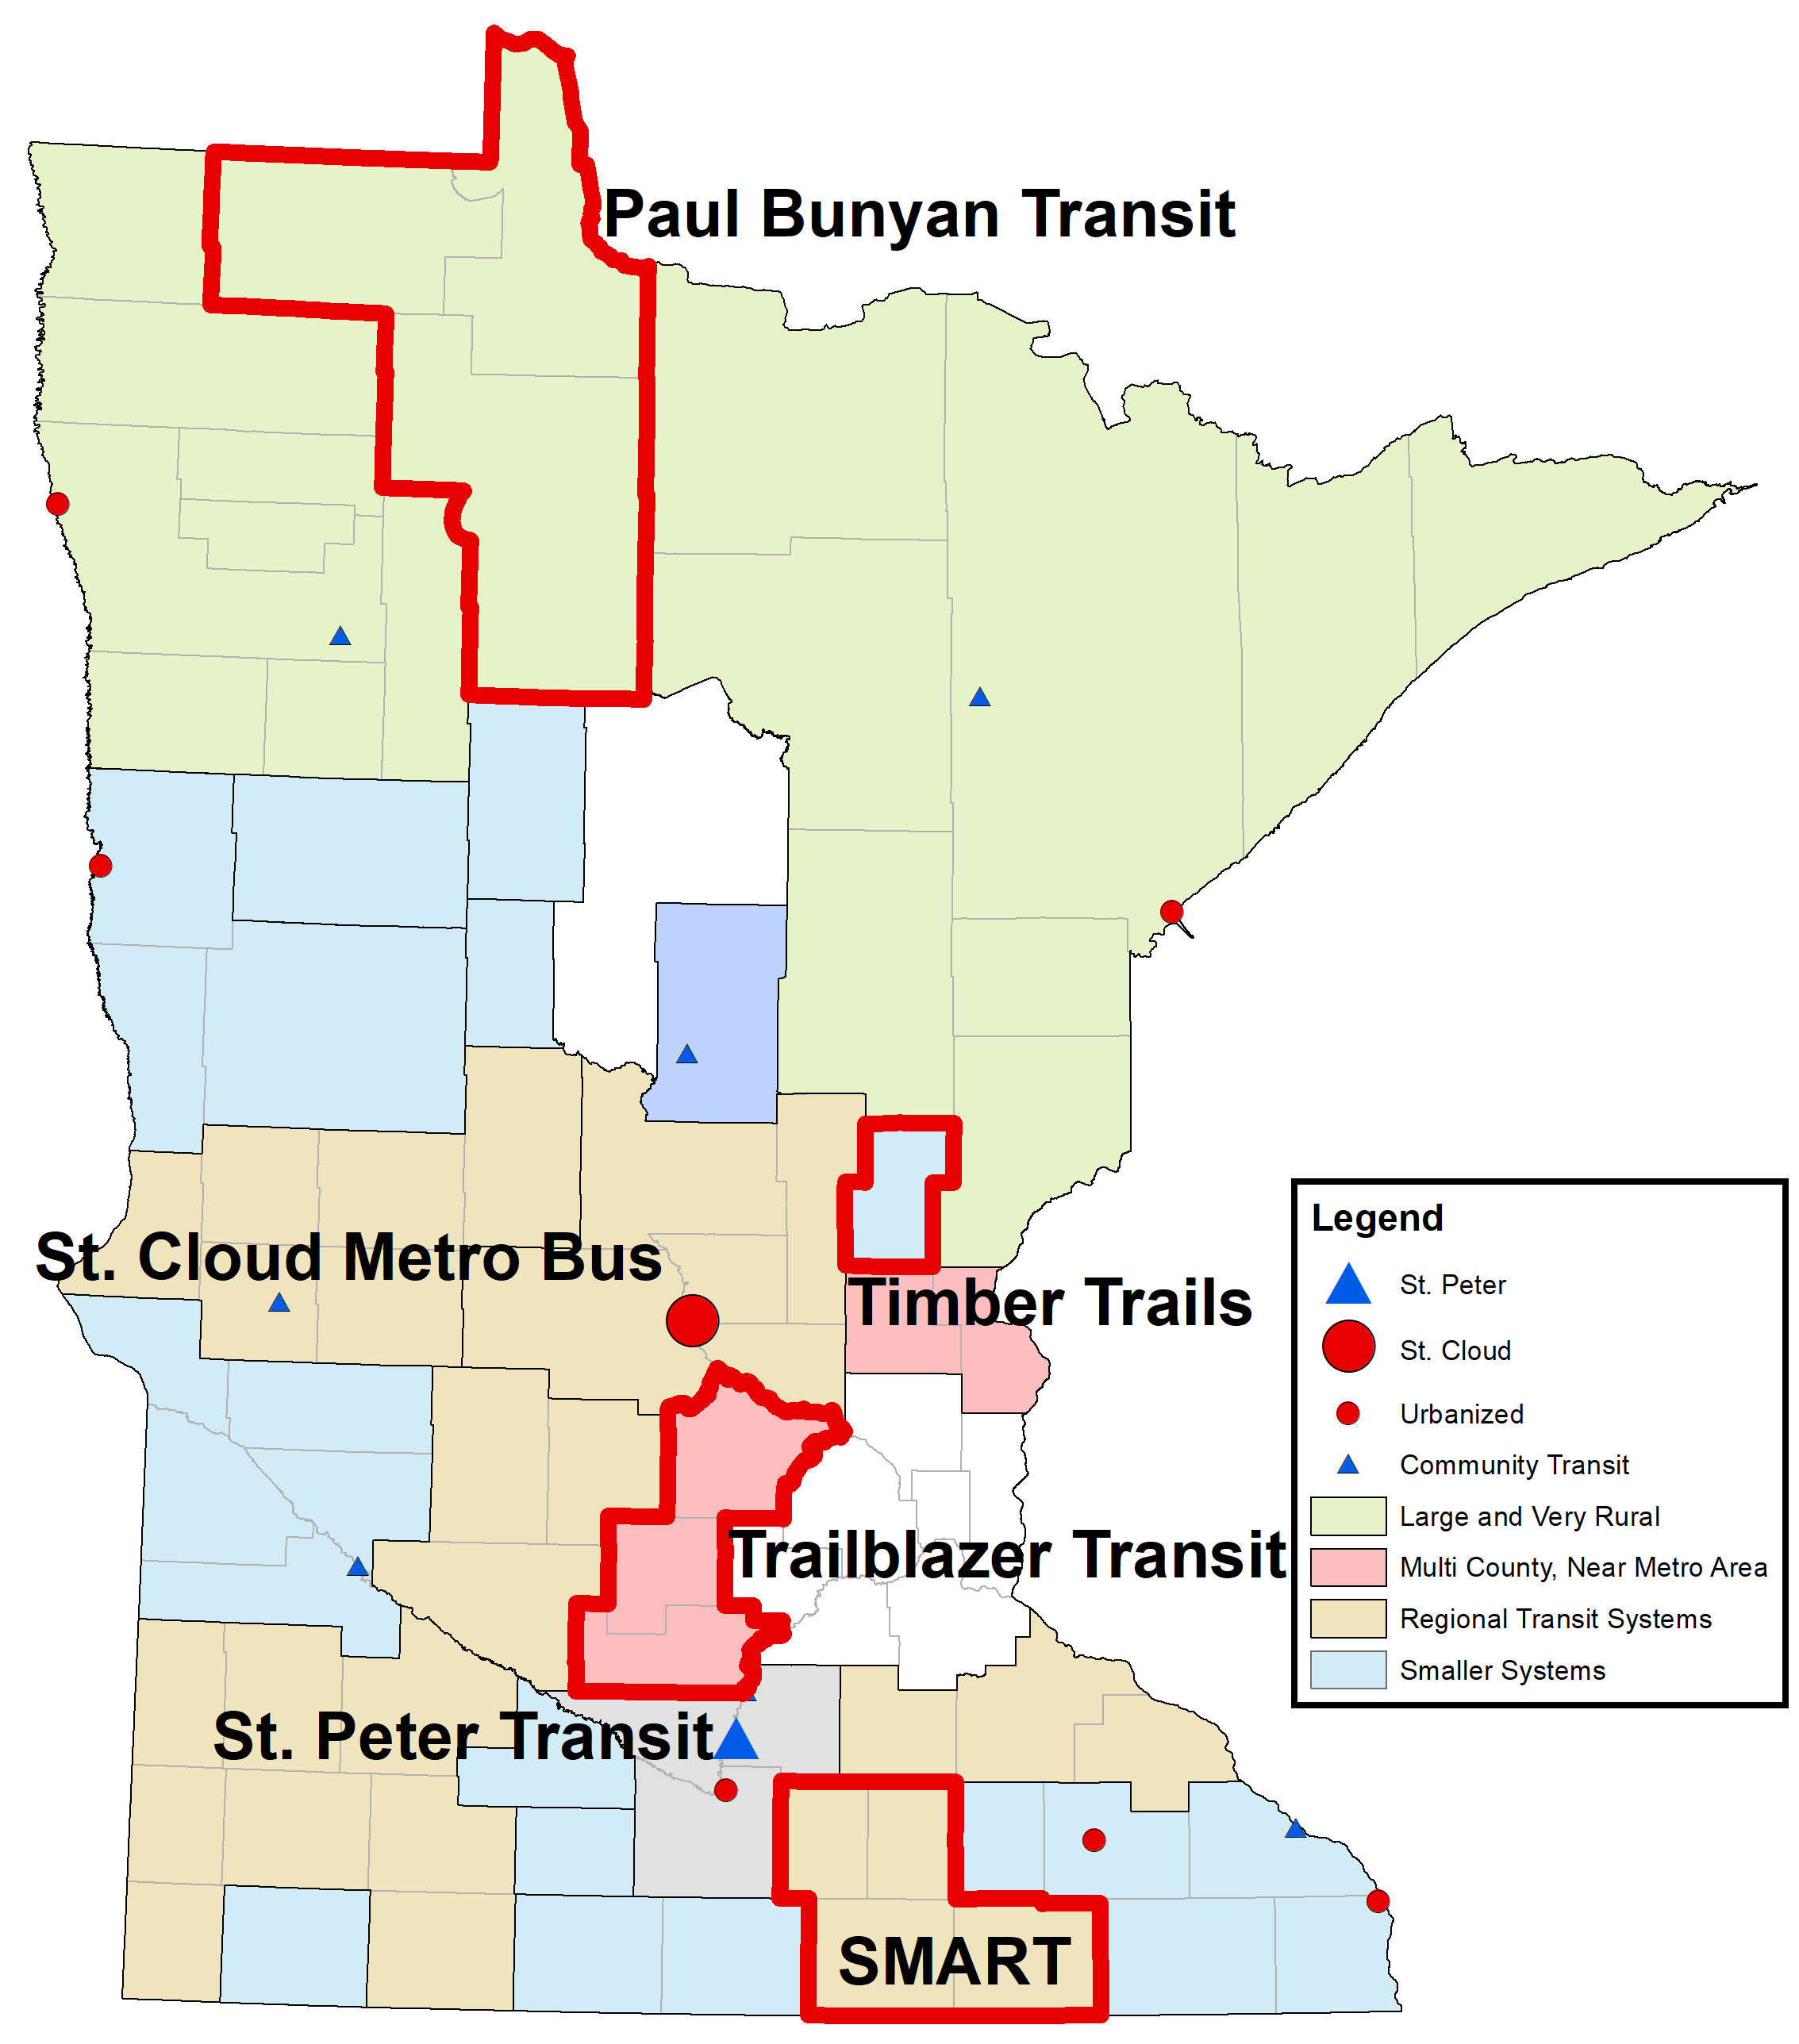

Slide 14
Onboard Rider Surveys
Transit Agency | Number of Survey Responses
Paul Bunyan Transit | 136
SMART | 103
St. Cloud Metro Bus | 477
St. Peter Transit/MRVT | 27
Timber Trails (Kanabec County) | 31
Trailblazer Transit | 156

Slide 15
How Respondents would have Made the Trip if Transit was Not Available
 | Paul Bunyan Transit | SMART | St. Cloud Metro Bus | St. Peter Transit | Timber Trails | Trailblazer Transit
 | ---------------------Percentage of respondents---------------------
I would not have made this trip | 32 | 32 | 30 | 35 | 23 | 41
Family member or friend | 23 | 27 | 20 | 35 | 10 | 16
Used a taxi, Uber, or Lyft | 5 | 16 | 23 | 9 | 0 | 3
Walked | 9 | 14 | 14 | 13 | 10 | 8
Volunteer driver | 5 | 2 | 3 | 4 | 3 | 5
Driven myself | 3 | 2 | 4 | 0 | 0 | 4
Bicycled | 2 | 3 | 3 | 0 | 3 | 3
Other | 21 | 3 | 3 | 4 | 50 | 20

Slide 16
Percentage of Respondents that would Miss Health Care Trips without Transit
 | Paul Bunyan Transit | SMART | St. Cloud Metro Bus | St. Peter Transit | Timber Trails | Trailblazer Transit
 | -----------------------Percentage of respondents-----------------------
Yes, many | 18 | 14 | 22 | 27 | 17 | 4
Yes, few | 23 | 23 | 28 | 14 | 20 | 11
No | 59 | 63 | 50 | 59 | 63 | 84

Slide 17
Need to Relocate
Survey Response | Paul Bunyan Transit | SMART | St. Cloud Metro Bus | St. Peter Transit | Timber Trails | Trailblazer Transit
 | -----------------------Percentage of respondents-----------------------
I could continue living in my current place | 73 | 73 | 55 | 75 | 81 | 83
I would move somewhere nearby | 18 | 13 | 24 | 8 | 6 | 10
I would move to a different town or city | 9 | 13 | 21 | 17 | 13 | 7

Slide 18
Intangible User Benefits of Transit, SMART
 | Strongly agree | Agree | Neutral | Disagree | Strongly Disagree
Allows me to make more trips | 68% | 21% | 10% | 1% | 0%
Increases my social interaction | 54% | 23% | 23% | 1% | 0%
Reduces by stress level | 52% | 34% | 13% | 1% | 0%
Allows me to live independently | 69% | 23% | 9% | 0% | 0%
Improves my overall quality of life | 65% | 24% | 12% | 0% | 0%

Slide 19
Importance of Transit for Getting to Work
Survey Response | Paul Bunyan Transit | SMART | St. Cloud Metro Bus | St. Peter Transit | Timber Trails | Trailblazer Transit
 | -----------------------Percentage of respondents-----------------------
Very important, I would lose my job | 58% | 86% | 68% | 43% | 100% | 56%
Somewhat important, I might lost my job | 17% | 2% | 13% | 14% | 0% | 29%
Slightly important, I would probably keep my job | 15% | 7% | 13% | 14% | 0% | 10%
Not important, I would keep my job | 10% | 5% | 6% | 29% | 0% | 5%

Slide 20
Demographics of Transit Riders
Population group | Paul Bunyan Transit | SMART | St. Cloud Metro Bus | St. Peter Transit | Timber Trails | Trailblazer Transit
Minority (non-white) | 29% | 20% | 31% | 21% | 6% | 9%
Income less than $25000 | 77% | 73% | 66% | 72% | 90% | 71%
No driver's license | 71% | 70% | 72% | 73% | 87% | 76%
No vehicles in household | 66% | 85% | 69% | 70% | 81% | 50%
Disability | 70% | 47% | 49% | 63% | 81% | 63%
Age 65 or older | 22% | 21% | 21% | 50% | 12% | 19%
Age 75 or older | 11% | 17% | 8% | 31% | 6% | 5%

Slide 21
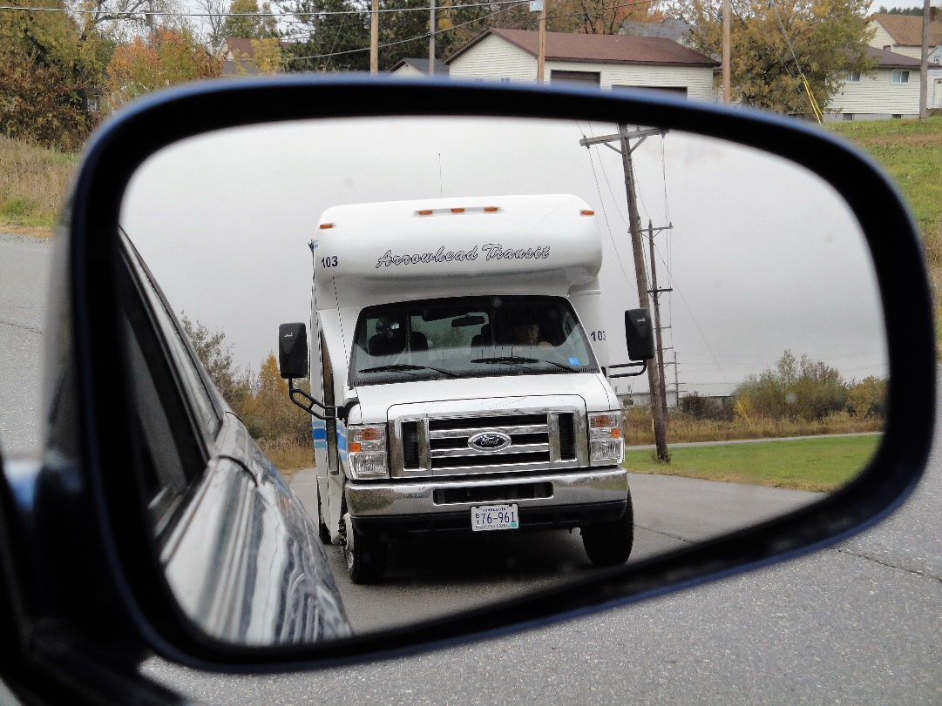
Estimated Mobility Benefits
Health benefits – very large
Low-cost mobility benefits - important
Relocation cost savings – not measured
Intangible benefits – not monetized, very important
Public cost savings
Productivity – not monetized
Equity – not monetized, very important
Option value - not measured

Slide 22
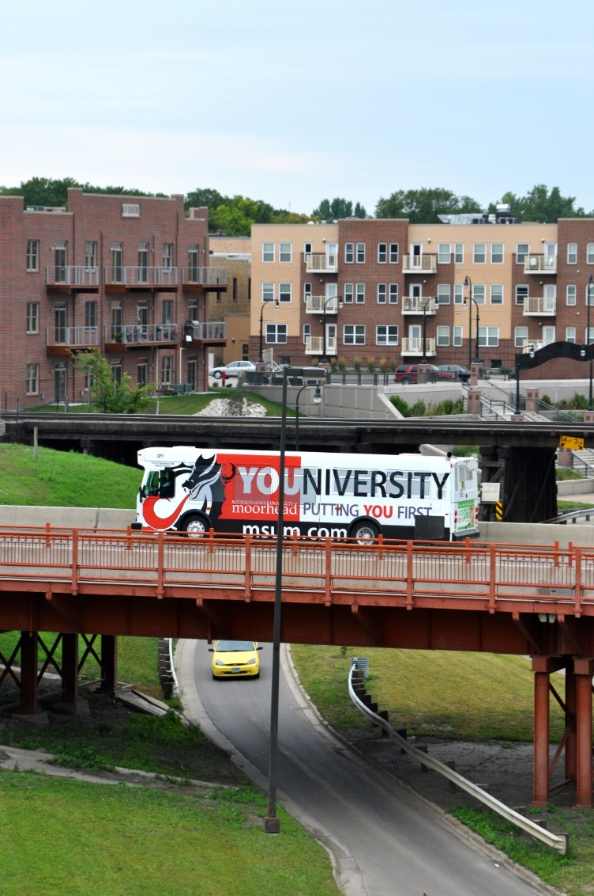
Estimated Efficiency Benefits
Vehicle cost savings – small
Chauffeuring cost savings – can be significant
Travel time impacts – small or negative
Safety benefits – small
Environmental benefits – likely negative
Health benefits – not measured

Slide 23
Economic Impacts from Transit Spending, SMART
Impact Type | Employment | Labor Income ($M) | Value Added ($M) | Output ($M)
Direct Effect | 65 | 1.94 | 1.94 | 2.54
Indirect (Supplier) Effect | 3 | 0.18 | 0.24 | 0.76
Induced (Income Re-spending) Effect | 12 | 0.64 | 1.13 | 1.89
Total Effect | 80 | 2.75 | 3.31 | 5.19

Slide 24
Would Transit Riders Spend More Money Online if Transit was Not Available?
Survey Response | Paul Bunyan Transit | SMART | St. Cloud Metro Bus | St. Peter Transit | Timber Trails | Trailblazer Transit
 | -----------------------Percentage of respondents-----------------------
Spend more online | 20% | 34% | 38% | 42% | 39% | 31%
Not spend more online | 80% | 66% | 62% | 58% | 61% | 69%

Slide 25
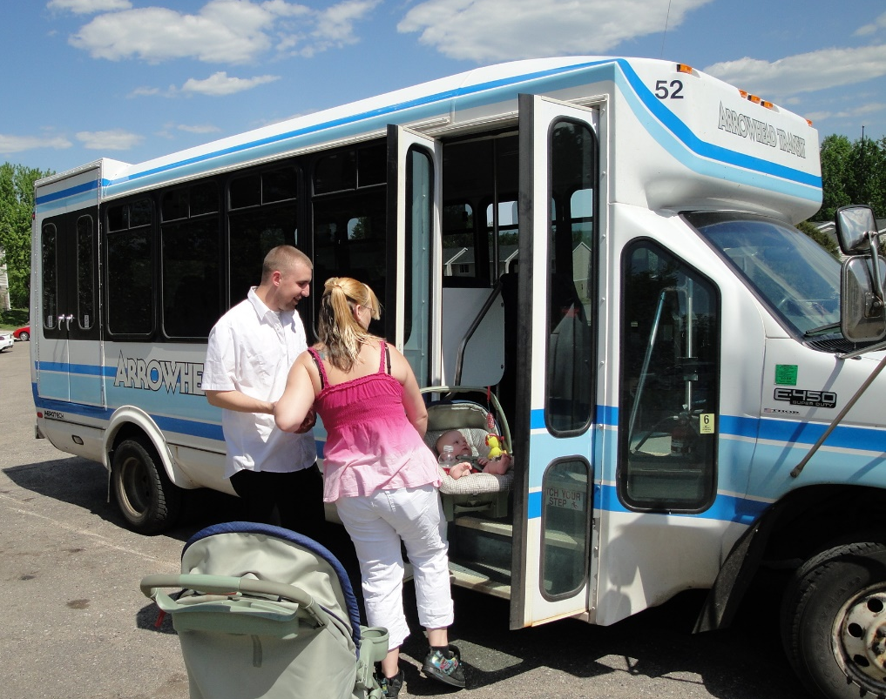
Direct Benefits of Research
Provides data and information for transit directors as they request and compete for local funding resources
Provides evidence for the Legislature when MnDOT requests increased funding
Enables MnDOT to better understand the benefits of its investments

Slide 26
Thank you!
Questions?
Jeremy Mattson jeremy.w.mattson@ndsu.edu
www.surtc.org
Sara Dunlap, MnDOT Project Manager
Sara.dunlap@state.mn.us
651-366-3312

