Slide 1
SouthWest Transit’s Microtransit Service

Slide 2
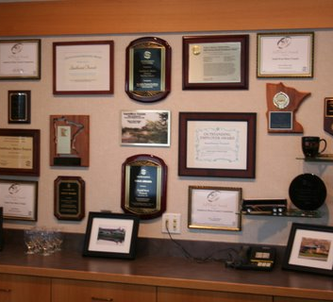
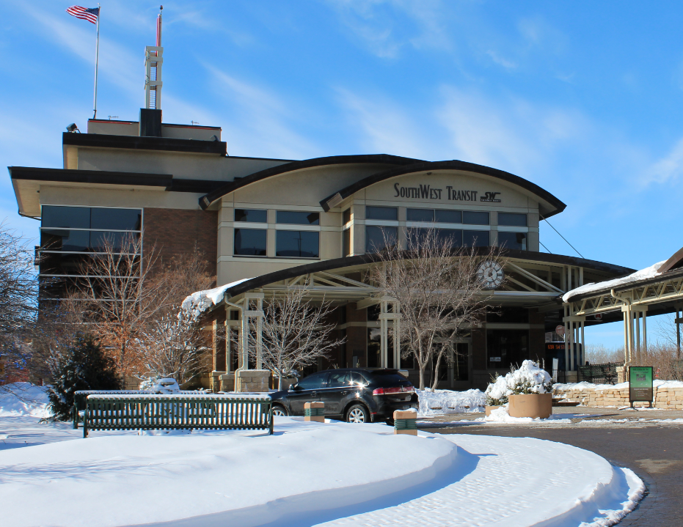
Who We Are
Public Transportation serving southwestern suburbs of Minneapolis: Eden Prairie, Chanhassen, Chaska, Carver, and Victoria
Over 1,000,000 rides annually
80% Fixed Route
10% Microtransit
10% Special Events
Large majority of ridership is park and ride express trips to/from downtown Minneapolis and the University of Minnesota
Multiple Real Estate holdings
First suburban TOD in the region
State and National award winner
Motto - “Expect the Best”

Slide 3
WHAT IS SW PRIME?
First of its kind shared ride microtransit service in Minnesota. Service began operating in 2015.
The general public can request a ride on demand only. No advanced scheduling.
Curb-to-curb service.
Serving Eden Prairie, Chanhassen, Chaska, Victoria and Carver (Southdale Transit Center on Saturdays).
Scheduling software (Spare) used to book and route the rides.

Slide 4
WHY PRIME?
Need for a lower cost local service option.
Prior attempts at traditional circulators/demand-response services were cost prohibitive.
Increase in demand for first mile/last mile services.
Need for local service with minimal support staff.
Technology evolution.
Tech-savvy service area population.
Long track record of service innovation.
Willingness to take a risk.

Slide 5
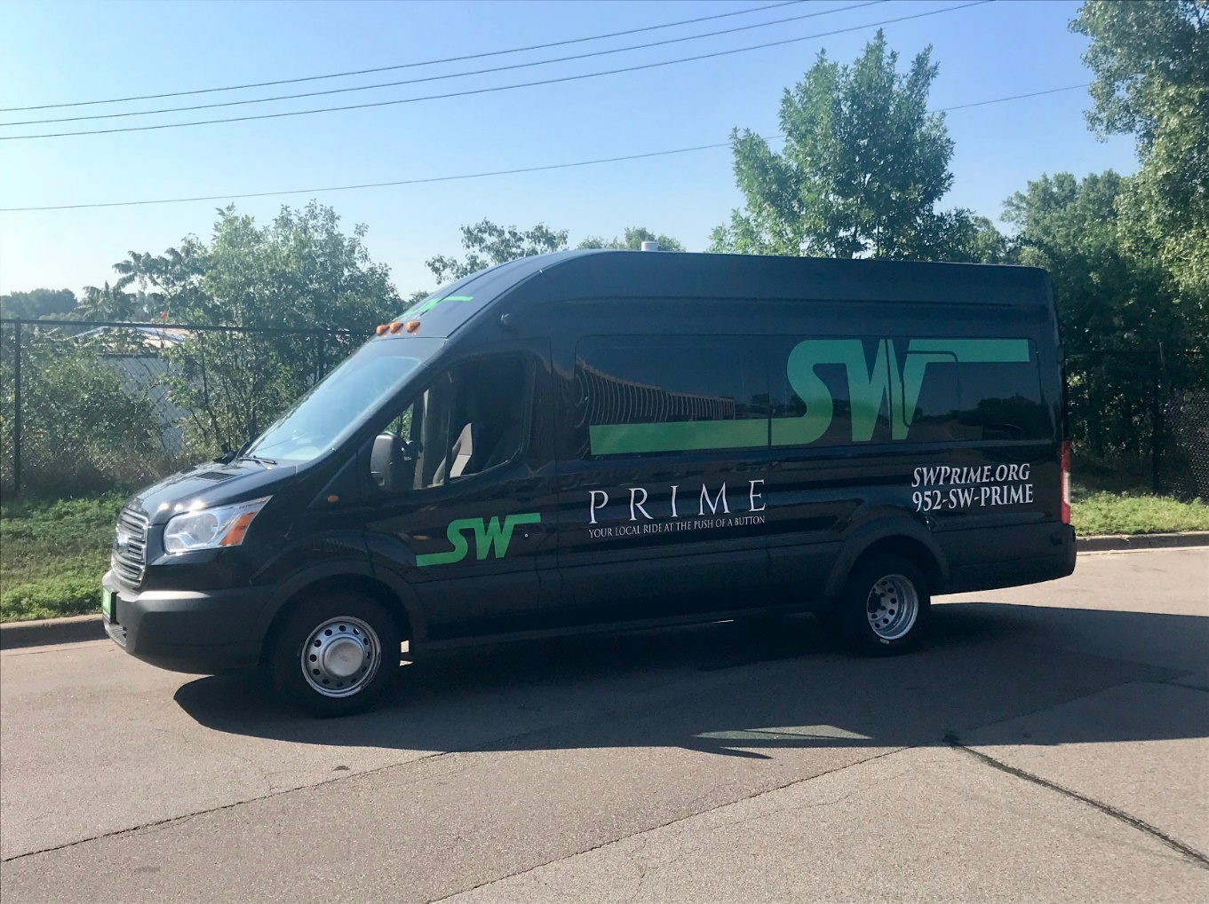
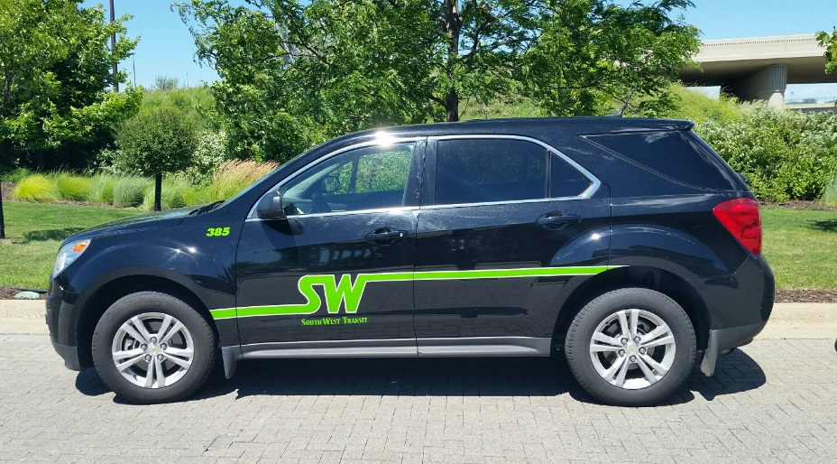
SW PRIME FLEET

Slide 6
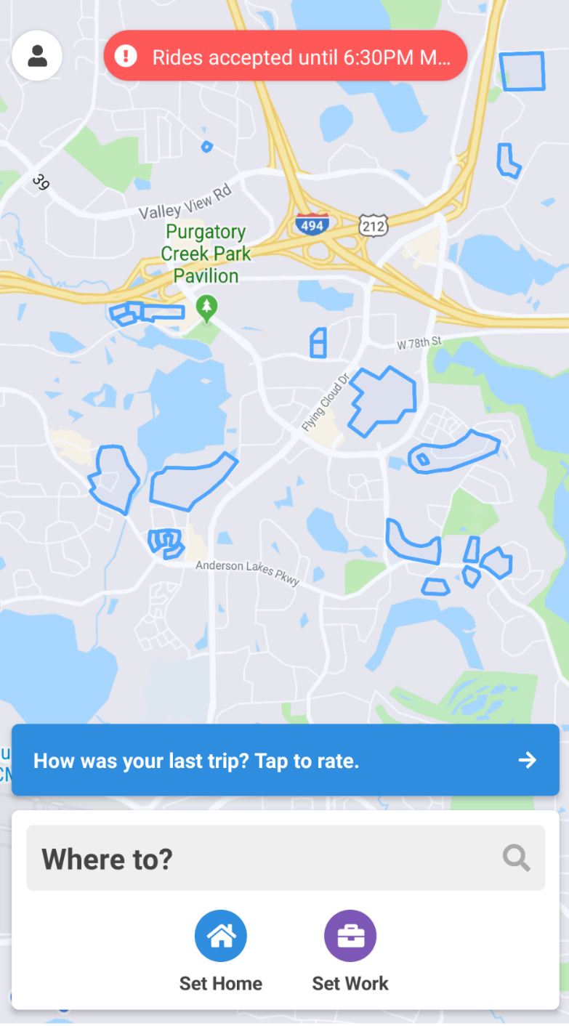
How do I book a PRIME ride?
1. By Phone
2. Using your app
Rides booked within 20 seconds.
Rides are confirmed automatically via SMS message.
Track vehicle location live using the app.
Notifications sent automatically upon vehicle arrival.

Slide 7
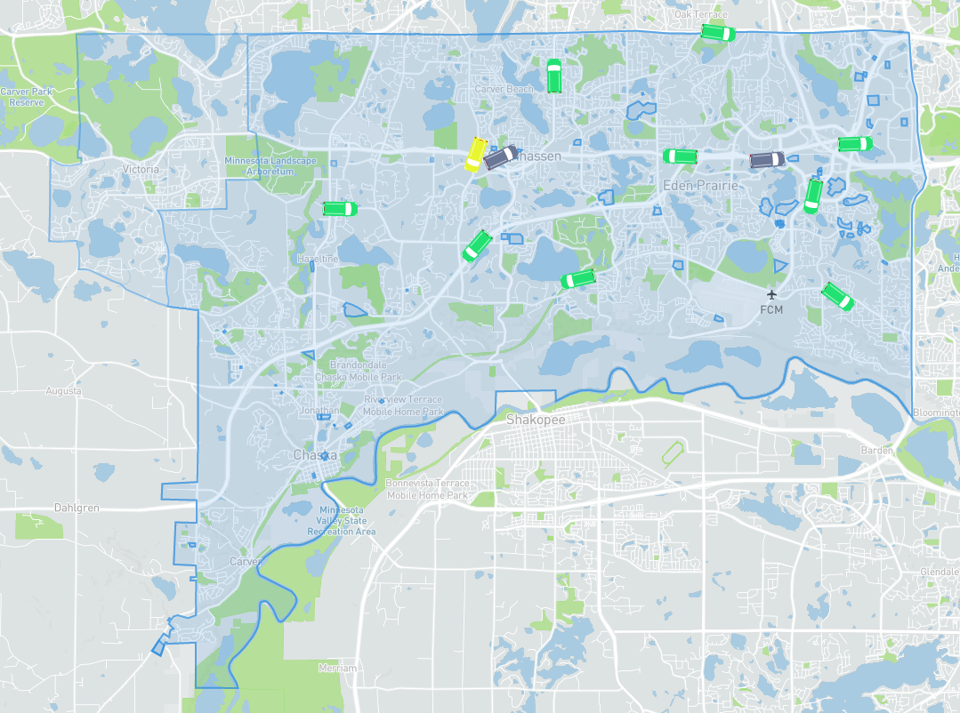

Slide 8
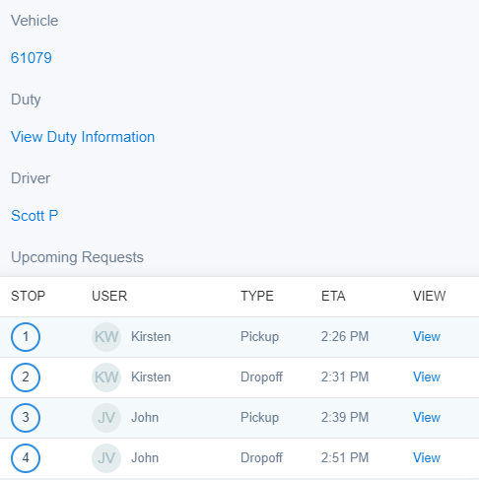

Slide 9
SW Prime Service Information
SW Prime service is available Monday – Friday: 6:30 am (First Pickup) – 7:00 pm (Last Pick Up); Saturday 10am – 4pm (Includes Southdale Mall)
No new reservations will be taken after 6:30pm (3:30pm on Saturdays)
Each ride is booked separately, meaning each leg of the trip is considered one ride
$5.00 per adult, per ride.
$4.00 for kids between the ages 6 and 12 when accompanied by a paying adult (18 years of age or older).
Free for kids 5 and under when accompanied by a paying adult (18 years of age or older).
$1.00 for seniors on Mondays between 9:00am-3:00pm & all day Saturday
Free transfers to and from SouthWest Transit express services.

Slide 10
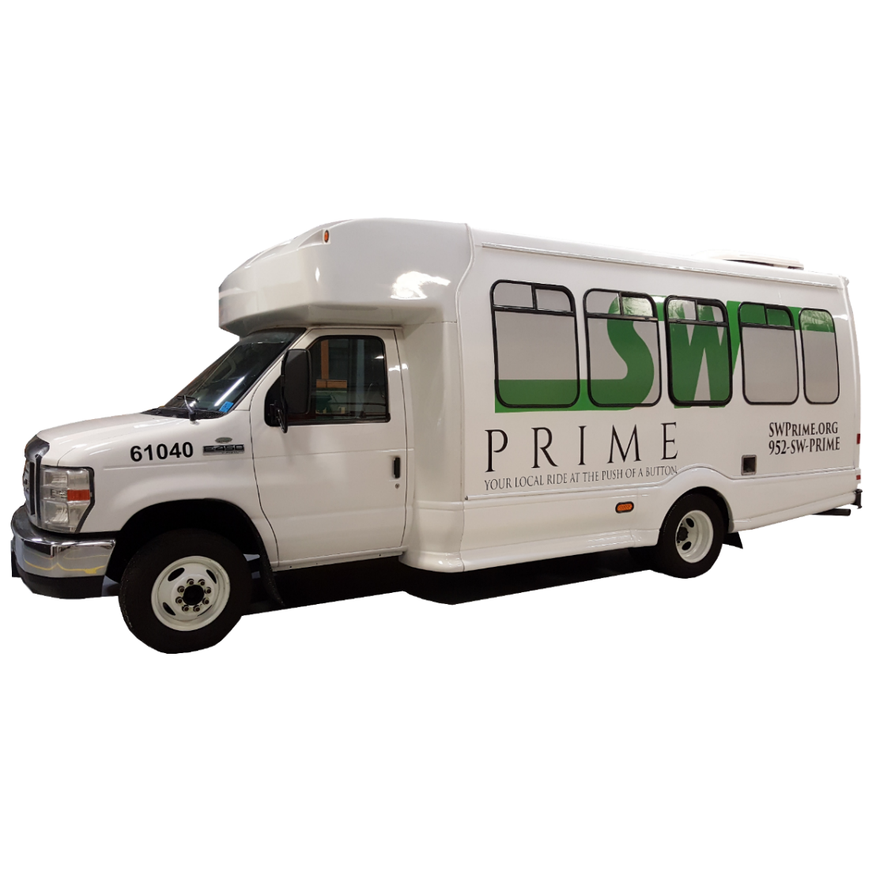
Prime Performance September 2019
Average Ride Time: 9.43 minutes
Average Wait Time:17.14 minutes
Average Daily Riders: 409
Passengers Per In-Service Hour: 2.93
Peak Buses Used: 14
Avg Subsidy Per Passenger: $8.63
Ride Booking Method
65% Online
35% Phone

Slide 11
SouthWest Prime MD
In October 2019, SouthWest Transit will launch a new service – SW Prime MD.
Prime MD will be an extension of the current Prime service and will provide Non-Emergency Medical Trips (NEMT).
Prime MD will service hospitals and clinics within the current service area and to select locations outside of the SouthWest service area.
Riders will be able to schedule their trip up to two weeks in advance ensuring that they make it to their appointments on time.
When riders are done with their medical appointments they simply will request an on-demand ride online or over the phone and a vehicle will be there to pick them up within minutes.
Partnering with Ridgeview Medical for subsidized trips.
The case for NEMT services:
Patients who can’t get to their medical appointments cost the nation’s healthcare system an estimated $150 billion each year.
3.6 million people miss or delay medical care each year because they lack available or affordable transportation.
Reduces barriers to healthcare transportation, improving access for people who are often frail and vulnerable.

Slide 12
494 Prime Service
CMAQ Grant funded.
Both on-demand and scheduled ride capabilities
Implementing scheduling aspect for MSP Airport and Mall of America service.
Incorporating regional transit hubs in service area to facilitate regional travel.
At least 8 additional vehicles & all-day service Monday through Saturday

Slide 13
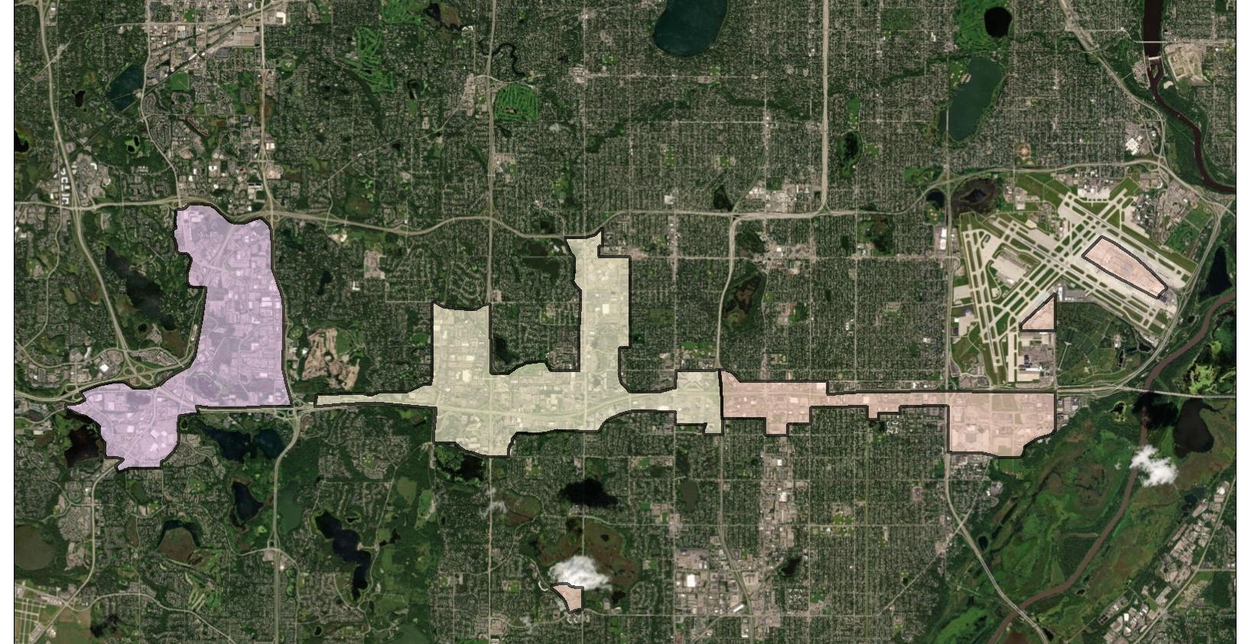

Slide 14
What about TNC’s?
SWT has had a past partnership with Lyft and is currently in discussions with Uber.
Seeking to supplement current Prime services as well offer service outside of current service hours (ex: airport)
Voucher Program
Hurdles
Title VI
ADA
Service quality/reliability
Data Sharing
Ride sharing
Suburban/exurban TNC supply

Slide 15
Questions?
Matt Fyten
Director of Operations & Planning
SouthWest Transit
mfyten@swtransit.org
952-974-3111
Charlie Cochrane
Transit Planner
SouthWest Transit
ccochrane@swtransit.org
952-974-3130

