Slide 1
Transit Technology and Greater Minnesota
Andrew Carpenter
Deputy Director, National Center for Applied Transit Technology
Notes:
Learn about and deploy technology from outcome-based approach. We don’t want a theoretical discussion of technology. But whether from an AV implementation down to fare payment integration, on-demand to fixed route, the idea is what specific outcome are you trying to achieve that the lack of technology is holding you back. We don’t want it to be solutions looking for problems. We’re working on folks to come along to say “I have this issue, I could do this well if I have X” what’s X?
If it’s not purpose-driven, given the size of your agency/staff, it won’t happen

Slide 2
So, you want some technology
What are your needs?
  How did you get to that?
How will you prioritize with the resources you have?
  What will get you closest to accomplishing your goals?
Who can you collaborate with?
  Group resources, band together!
  Learn from peers – pitfalls, strategies, etc.
Notes:
Let’s start at a very high level:
Because “technology” has become hyped as a solution to everything, it’s easy to jump to the need for a piece of tech to solve a problem you face. First, though, you need to get to the root of the issue: what do you hope to accomplish, why, and what causes that? If you just raised fares and cut service, technology isn’t the answer – you have a more fundamental problem.
Sometimes, though, you need a technological tool to address the issues you want to tackle. And that’s how you should think of it, as a tool, not an answer. For example, if you need to streamline your service you can get route planning software, or for demand-response you can look for something that will group trips efficiently.
Sadly, you probably don’t have the resources to acquire every tool you need. So what do you most need to accomplish, and what can have the biggest impact on your service?
Collaboration: this is new, but could work. There are, of course, plenty of limitations, but it’s feasible and there are some examples of small municipalities doing this. There are plenty of questions to answer if you go this route, but think about it.

Slide 3
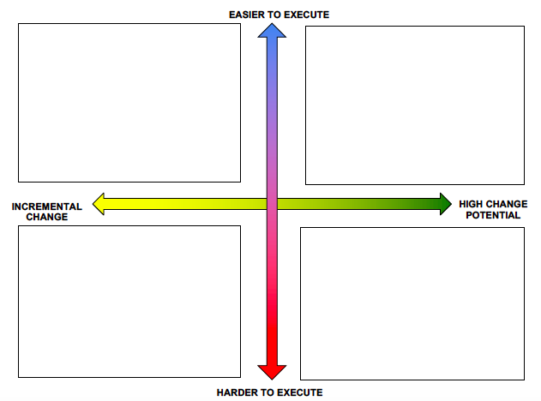
Prioritizing Your Resources
Notes:
Also think about opportunities to build on existing initiatives within your community – is there political momentum, or are there businesses or organizations hoping to accomplish something through which you can work?
When it comes to applying something new, or exploring a new idea, it can be easy to get caught up in your idea without rationally thinking through it. But it’s important to map it out regarding how it will work across your agency’s initiatives/efforts, and think through it. Another way to work on prioritizing your technology is:
● The concept(s) that is the most “rational choice” - Mark with an “R”
● The concept(s) that is most likely to delight customers - Mark with a “C”
● The concept(s) that is the “darling”, the one or two you just love and can’t bear to part with - Mark with a “D”
● The concept(s) that is a long shot - Mark with an “L”

Slide 4
Categories of tech
Operations
Vehicles
Customer Service/Payment
Outreach and Access
Data

Slide 5
Operations
Routing and Planning
Scheduling and Dispatch
New Service Models
  Dynamic/real-time demand-response
Notes:
Gila County, AZ: consolidating county-based services into one space. You can “reserve” vehicles, un-silo them for use across services. CTAA has also been working on this concept in Southern Maryland
https://www.govtech.com/data/Big-Data-An-On-Ramp-to-Better-Fleet-Management.html

Slide 6
Vehicles
Maintenance
  Parts tracking
  Maintenance scheduling
New Vehicles
  Electric buses
  Smart tires
  Purpose-built paratransit
Notes:
Parts and maintenance: Butch McDuffy in Athens, GA
Vehicles: talk to Halsey King

Slide 7
Customer Service/Payment/Access
Mobility as a Service
  Trip planning
  Vehicle arrivals
  Inter-agency coordination/collaboration
Mobile ticketing
Branding/communications
Incentive programs
Notes:
Branding/comms – DCPL and DC Water Twitter wars
Incentives: Hampton Roads Transit pilot https://www.masstransitmag.com/technology/fare-collection/mobile-applications/article/21106661/moovels-loyalty-and-rewards-program-aims-to-connect-communities-through-incentivized-transit-use

Slide 8
Data
Not tech in itself, but enabled by technology
Helps make decisions
  Improves efficiency
  Improves service distribution
Notes:
Case studies of good use of data: NYC and Via – improving decision-making, routing, and efficiency, saving $X - “data deficits,” or a lack of information, can prevent systems from optimizing their fleets, understanding their populations, reducing costs and from improving service
Cons: Drinking from a firehose, privacy implications

Slide 9
It’s worth it! Probably
Be deliberate
Learn vendor-speak
Test, test, test
Determine the return on investment
Notes:
Case studies on how this works in small urban/rural areas:
Duluth electric buses
There are start-ups starting up every day. You’ll have to sift through them, but there are some that are smart and are good assets. But be careful – we’ve been burned, especially be the “yeah sure we can do that.” but listen for those who ask good questions.
There are a bunch of tech companies finding their niche in what they provide to agencies. So there’s nuance in their products – this is good for tailor-fitting. But can be risky if shoe-horning them into what you want to accomplish.

Slide 10
Funding Opportunities
FTA Innovation Grants
  IMI
  ICAM
TA Center Grants
  NCMM
  N-CATT
  SUMC
Foundation Grants

