Slide 1

Processes and Procedures for Perfect Procurements
Jean Meyer, MnDOT
Danette Tessmann, WisDOT
2018 MN/WI Public Transit Conference
La Crosse, WI
October 17, 2018

Slide 2
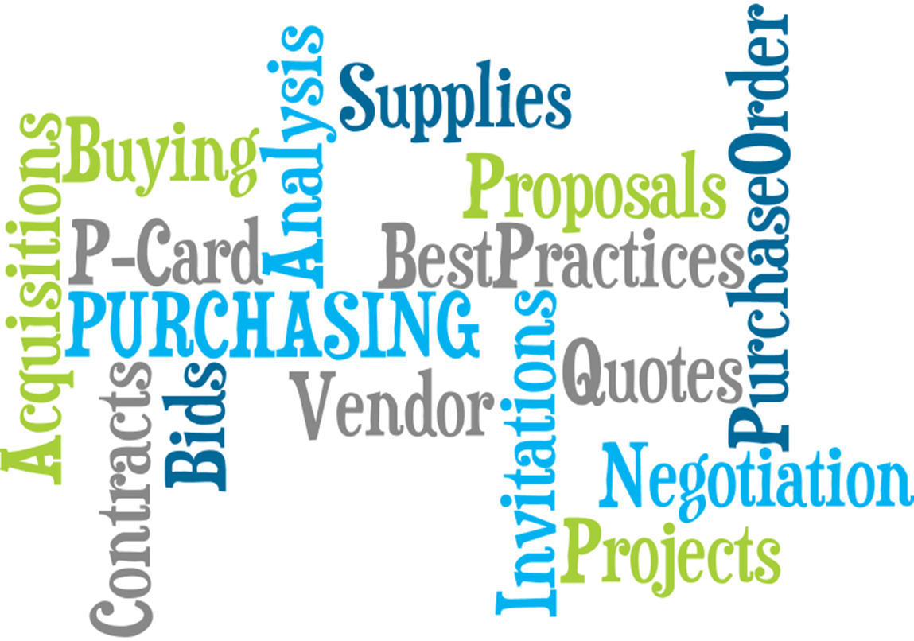
Introduction
The “Golden Rule”…They who have the gold, make the rules!
If one penny of FTA money is used in the procurement, then all of the FTA requirements must be met.

Slide 3
Overview
Procurement Responsibilities
Procurement Planning
Procurement Process
Procurement Types
Key Elements in all Procurements
Contract Basics
Procurement Tools and Resources
Contact Information
Notes:
WisDOT Resources:
WisDOT Transit Procurement Website
MnDOT Resources:
http://www.dot.state.mn.us/transit/grants/procurement.html
Key FTA Resources:
FTA Master Agreement dated 10/1/2017
Circular 4220.1F – Third Party Contracting Guidance
FTA Best Practices & Lessons Learned Procurement Manual

Slide 4
Procurement Responsibilities
As a recipient of FTA funds, you are responsible for:
  Ensuring full and open competition and equitable treatment of all potential bidders/suppliers in the procurement process
  Planning, solicitation, award, administration, and documentation of all FTA funded contracts
  Maintenance of a Contract Administration System to ensure that contractors perform in accordance with the terms, conditions, and specifications of their contracts or purchase orders
  https://www.transit.dot.gov/sites/fta.dot.gov/files/docs/funding/procurement/8286/fta-best-practices-procurement-and-lessons-learned-manual-2016.pdf
Notes:
A properly documented procurement file provides an audit trail from the initiation of the acquisition process to the beginning of the contract. A well-documented file can be interpreted on its own, without any assistance or additional information.
Section 5 of the Best Practices Procurement Manual reviews the Contract Administration requirement.

Slide 5
Procurement Responsibilities
Federal Requirements
vs
  Local Requirements
  Federal requirements usually trump local requirements, unless local requirements are more restrictive than federal.
Notes:
On June 20, 2018 the Office of Management and Budget (OMB) issued a memorandum changing the micro purchase and small purchase thresholds. The micro purchase threshold is now $10,000 but in Wisconsin and Minnesota the threshold is $5,000. Small purchases under FTA requirements are all purchases under $250,000, but in Wisconsin, small purchases are those under $50,000. In Minnesota, small purchases are those under $100,000.
The new small purchase threshold does not apply to the Buy America statute of $150,000.

Slide 6
Procurement Planning
Procurement planning is initiated well before a contract solicitation is made.
Activities may include:
  Needs definition
  Estimated cost
  Identification of financial resources culminating in a grant application
Notes:
Minnesota: resource of Procurement Checklist
http://www.dot.state.mn.us/transit/grants/procurement.html

Slide 7
Procurement Process
Planning the Solicitation
Conducting the Solicitation
Awarding the Contract
Administering the Contract
  Contract Monitoring/Administration
  Contract Modifications
  Exercising Options (if applicable)
Contract Close Out
Notes:
Step 1. Planning the Solicitation: Planning the solicitation should be done with the WisDOT Program Manager OR MnDOT Project Manager to ensure grant funds and local match are approved for the items to be procured.
Step 2 and 3. Conducting the Solicitation and Awarding the Contract Work with the WisDOT Procurement Manager OR MnDOT Procurement Coordinator to conduct the solicitation through contract award.
Step 4. Contract Administration. This step includes contract monitoring , administration and contract modifications and is done with the assistance of the WisDOT Program Manager OR MnDOT Project Manager.
Step 5. Contract close out. A complete procurement file should include documents such as: copies of all invoices, documentation of any contract modifications, correspondences with the vendor, and copies of all required reports from the solicitation. Work with the WisDOT Program Manager and/or the WisDOT Procurement Manager OR MnDOT Project Manager and/or MnDOT Procurement Coordinator if you have any questions about file completeness.

Slide 8
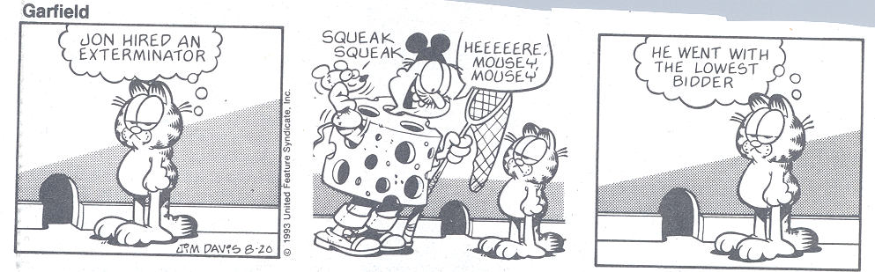
Notes:
Procuring commodities or services is more than just selecting a low bid. It’s important to understand the types of procurements and the requirements for each.

Slide 9
Procurement Types
Micro-Purchase ($4,999 or less)
Small Purchase ($5,000-$49,999)
Invitation for Bid (IFB) (very detailed specifications are provided, public opening of bids)
Request for Proposal (RFP) (detailed specifications are not provided, source selection process)
Cooperative Vehicle Purchase (MnDOT conducts RFP and systems procure from vendors selected)
Human Service Vehicle (WisDOT conducts an IFB and subrecipients purchase vehicles from state contract)
Heavy Duty Bus (WisDOT conducts a RFP to develop a state schedule with multiple vendors for Wisconsin transit agencies to procure buses)
Notes:
Procurement Manuals and Toolkits are provided by procurement type to help minimize procurement errors and ensure all documentation that is required is complete and accurate.
IFB: WisDOT = over $50,000
MnDOT = over $100,000
RFP: WisDOT = over $50,000
MnDOT = over $100,000

Slide 10
Key Elements in all Procurements
While each procurement is unique, these key elements apply to all procurements and are consistently addressed in all toolkits:
          Written History of Procurement
          Independent Cost Estimate
          Specifications
          Bidders List
          Cost/Price Analysis
          Contractor Responsibility
          Federal Clauses
Notes:
Each toolkit has an appendix with instructions and a form to be completed for each of these items. Toolkits and appendices are on the WisDOT Transit procurement website.
Review forms -- MnDOT
http://www.dot.state.mn.us/transit/grants/procurement.html
Contractor Responsibility
Federal Clauses
These processes are incorporate at the time of the procurement to
assure compliance.

Slide 11
Key Elements (continued)
Written History of Procurement: FTA requires that grantees maintain records detailing the history of each procurement.
At a minimum, the following must be documented in the Written History of Procurement:
    The rationale for the method of procurement
    Selection of contract type
    Reasons for contractor selection or rejection
    The basis of the contract price
Notes:
Written History of Procurement:
This is a critical item in all procurements and is included in each of the toolkits.
This document is used to record action steps and decisions throughout the procurement.
The procurement cost and complexity will determine how much information is sufficient.
MnDOT form
http://www.dot.state.mn.us/transit/grants/procurement.html
WisDOT
https://wisconsindot.gov/Pages/doing-bus/local-gov/astnce-pgms/transit/procure.aspx

Slide 12
Key Elements (continued)
Independent Cost Estimate (ICE): This required element is the anticipated cost for the item or service to be procured. The ICE is:
  Completed prior to contract solicitation
  Not developed by a potential bidder
  Used in determining whether price is fair and reasonable
  Can help determine procurement type
Notes:
ICE:
To be considered “independent,” the estimate cannot be developed by any potential source, supplier, or provider of the item, service, or project. However, it is acceptable to have an “independent” third party develop the estimate for the purchasing activity as long as that party has no interest in bidding or offering on the procurement.
For more complex procurements, the ICE represents the documented result of a practical and unbiased analysis, assessment, and quantification of all costs and risks associated with a particular procurement.
The ICE must be based upon the procurement’s technical specifications. Irrespective of the procurement’s complexity, the ICE serves as an essential tool for conducting the subsequent required cost or price analysis.
Important Note: Use the ICE form template in the toolkit. The research on the ICE and the ICE itself should be dated before advertising the solicitation. Make sure there is not a gap of time more than 1 week between the date on the research and the ICE.

Slide 13
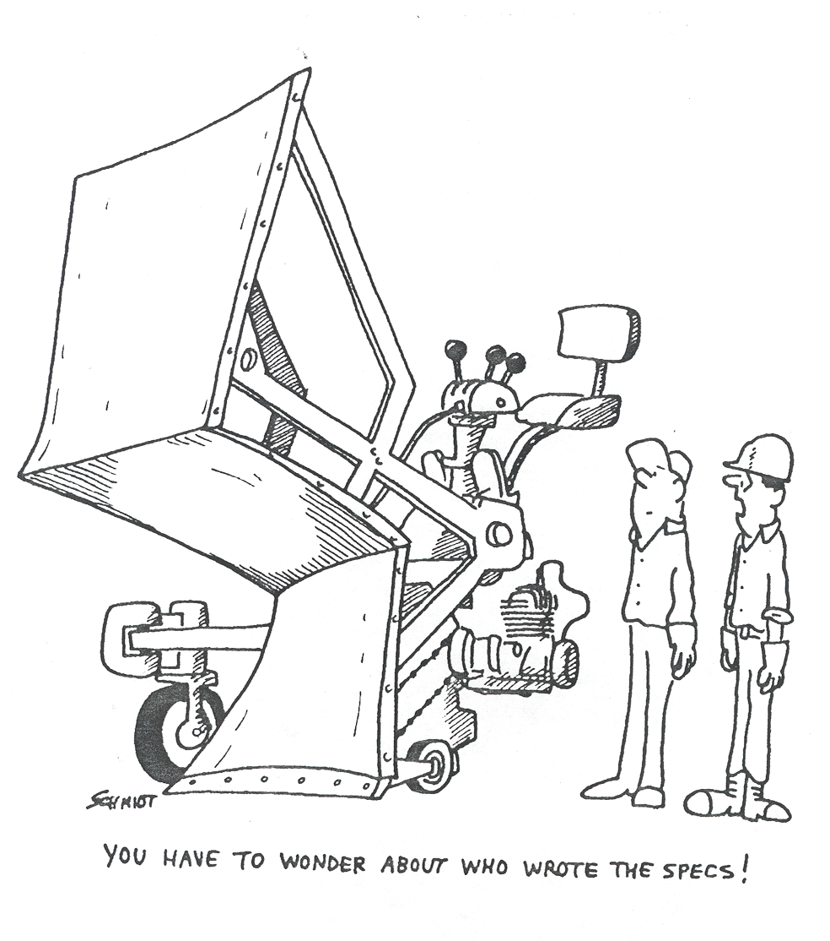

Slide 14
Key Elements (continued)
Specifications: A clear and accurate description of the technical requirements for the material, product, or service to be procured must be provided.
  Complete and accurate specifications ensure potential bidders are given equal knowledge of the contract requirements.
  No brand names.
  Not developed by a potential bidder.
  This allows for fair and open competition.
Notes:
Specifications:
Per FTA Circular 4220.1F, the description may include a statement of the qualitative nature of the property or services to be acquired. When practicable, the recipient should describe its requirements in terms of functions to be performed or level of performance required, including the range of acceptable characteristics or minimum acceptable standards.
Micro-Purchases, Small Purchases, and IFBs: Specifications should be as detailed as possible since the goal is to look for the lowest responsive, responsible bidder.
RFPs: Specifications do not need to be as detailed as Micros, Small and IFBs because the RFP process is used to look for the bidder/contractor to fill in any gaps of a service or product.
Brand Names should not be used whenever possible. If brand names are used, subrecipients must list the salient characteristics of the product so vendors know the product being procured.
Salient Characteristics is defined as those qualities of an item that are essential to ensure that the intended use of the item can be satisfactorily realized. The term is used in connection with a “brand name or equal” purchase description.

Slide 15
Key Elements (continued)
Bidders List: Both WisDOT and MnDOT maintain a required "bid opportunity list" generated from both subrecipient and WisDOT and MnDOT procurement activities.
The information collected:
  Reflects all firms that are participating, or attempting to participate on USDOT-assisted contracts
  Is used for DBE goal-setting purposes
  Helps ensure a level playing field in accessing contract opportunities
Notes:
Best Practices Procurement Manual: The bidders list is intended to be a count of all firms that are participating, or attempting to participate, on DOT-assisted contracts. The list must include all firms that bid on prime contracts or bid or quote subcontracts on DOT-assisted projects, including both DBEs and non-DBEs. DOT believes that bidders lists are a promising method for accurately determining the availability of DBE and non-DBE firms. The information gathered is used by WisDOT and MnDOT to calculate its three-year DBE goal.
Important Note:
Use the spreadsheet included in the toolkit. The spreadsheet must be sent to all vendors and must be completed for their respective company. If you are conducting a micro purchase online, track as much of the information as you can.
Office of Civil Rights – MnDOT
http://www.dot.state.mn.us/civilrights/

Slide 16
Key Elements (continued)
Cost/Price Analysis: The goal of the Cost/Price Analysis is to document whether the proposed costs are in line with what reasonable economical and efficient performance should cost.
  Cost elements examined include: materials, labor, equipment, overhead and profit.
  The Cost/Price Analysis is a determination of whether the price is “fair and reasonable”.
Notes:
Subrecipients should document the ICE and all of the submitted offers.
If a procurement is a multiple year contract, all years must be documented in the analysis. It is not enough to have a Consumer Price Index stated in solicitations, the actual costs must be included to be able to establish a fair and reasonable assessment.
An ICE and a cost analysis must be completed on all change orders.
Follow-up actions such as negotiating price, rebidding, etc. are necessary if price is not fair and reasonable.

Slide 17
Key Elements (continued)
Contractor Responsibility: Awards should only be made to responsible contractors possessing the ability to perform successfully under the terms and conditions of a proposed procurement. For every procurement type, grantees must determine whether a contractor is responsible and responsive.
Responsibility determination factors include:
  Appropriate financial, material, equipment, and personnel resources and expertise
  Capability to comply with the required delivery schedule
  A satisfactory record of performance and integrity
  Legal qualifications to contract with the grantee (www.sam.gov)
Notes:
Micro and Small Purchases: There are a couple of boxes on the Micro/Small Purchase Abstract that you must fill out and you must also check www.sam.gov and print it out.
Micro Purchase Form - MnDOT
http://www.dot.state.mn.us/transit/grants/procurement.html
Small Purchase method – MnDOT
http://www.dot.state.mn.us/transit/grants/procurement.html
IFB and RFPs: Complete the appendix in the toolkit specific to IFBs and RFPs.
Contractors must also be determined to be responsive to the bid requirements.
Responsive and responsibility determination must be done before awarding the contract.
IFB and RFP Methods – MnDOT
http://www.dot.state.mn.us/transit/grants/procurement.html

Slide 18
Key Elements (continued)
Federal Clauses: These FTA standards are reviewed for relevance and applicability to a procurement and included in the solicitation and eventual contract.
https://wisconsindot.gov/Documents/doing-bus/local-gov/astnce-pgms/transit/procurement/smr-clause.pdf
https://wisconsindot.gov/Pages/doing-bus/local-gov/astnce-pgms/transit/procure.aspx
https://www.transit.dot.gov/regulations-and-guidance/buy-america/buy-america-handbook
Notes:
Federal clauses do not have to be included with micro purchases, except construction projects over $2000 must include the applicable clauses.
Federal clause master list included in all procurement toolkit appendices.
Buy America requirements must be completed for all rolling stock procurements over $150,000
49 CFR Part 661 requires manufactured products to be manufactured in the United State unless qualifies for a waiver

Slide 19
Contract Basics
Contract: A mutually binding legal relationship obligating a seller to furnish supplies or services (including construction) and the buyer to pay for them.
  Includes a grantee’s contract with a vendor or contractor, including procurement by purchase order or purchase by credit card, which is financed with FTA assistance.
Notes:
Contracts must include total dollar amount, beginning and ending date, reference to solicitation, addendums, and federal clauses
Cardinal changes are not allowed. (A major deviation from the original purpose of the contract.) Be aware when doing change orders that they do not end up being cardinal changes.

Slide 20
Procurement Tools and Resources
Notes:
Procurement History File Checklist
This critical item in each toolkit ensures all of the required elements for the specific procurement type are documented in the procurement file.
This document records action steps and decisions throughout the procurement. The sample checklist must be properly annotated and filed for each procurement.
The volume of documentation associated with the procurement will dictate the number of files required to properly maintain a complete history of the procurement.
A well-documented file speaks for itself, without need of interpretation from the contract administrator.
A well-documented file also supports actions taken, provides information for reviews and investigations, and furnishes essential facts in the event of litigation or legislative inquiries.
See MnDOT Procurement History form
http://www.dot.state.mn.us/transit/grants/procurement.html

Slide 21
Procurement Tools and Resources
WisDOT Procurement Manual
http://wisconsindot.gov/Documents/doing-bus/local-gov/astnce-pgms/transit/procurement.pdf
MnDOT Procurement Guidance
In development/updates
Procurement Toolkits
http://wisconsindot.gov/Pages/doing-bus/local-gov/astnce-pgms/transit/procure.aspx
http://www.dot.state.mn.us/transit/grants/procurement.html
National Transit Institute
http://www.ntionline.com/
Notes:
WisDOT Resources:
WisDOT Transit Procurement Website
http://wisconsindot.gov/Pages/doing-bus/local-gov/astnce-pgms/transit/procure.aspx
MnDOT Resources:
MnDOT Transit Procurement Website
http://www.dot.state.mn.us/transit/grants/procurement.html
Key FTA Resources:
FTA Master Agreement dated 10/1/2017
Circular 4220.1F – Third Party Contracting Guidance
FTA Best Practices Procurement Manual
NTI Training
http://www.ntionline.com/

Slide 22
Procurement Tools and Resources
FTA Third Party Procurement FAQs
https://www.transit.dot.gov/funding/procurement/third-party-procurement/third-party-procurement-faqs
FTA Best Practices Procurement Manual
https://www.transit.dot.gov/sites/fta.dot.gov/files/docs/funding/procurement/8286/fta-best-practices-procurement-and-lessons-learned-manual-2016.pdf
Third Party Contracting Guidance-Circular 4220.1F
https://www.transit.dot.gov/regulations-and-guidance/fta-circulars/third-party-contracting-guidance

Slide 23

Comments and Questions?

Slide 24
Contact Information
MnDOT Procurement Coordinator
Jean Meyer
(507) 286-7596
jean.meyer@state.mn.us
WisDOT Procurement Manager
Danette Tessmann
(608)266-8165
danette.tessmann@dot.wi.gov

