Slide 1
SouthWest Transit’s Microtransit Service
2018 MN / WI Public Transportation Conference
Wednesday, October 16th

Slide 2
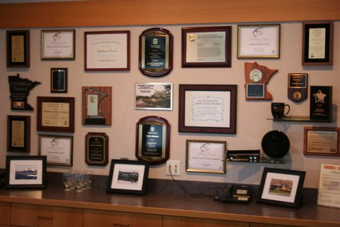
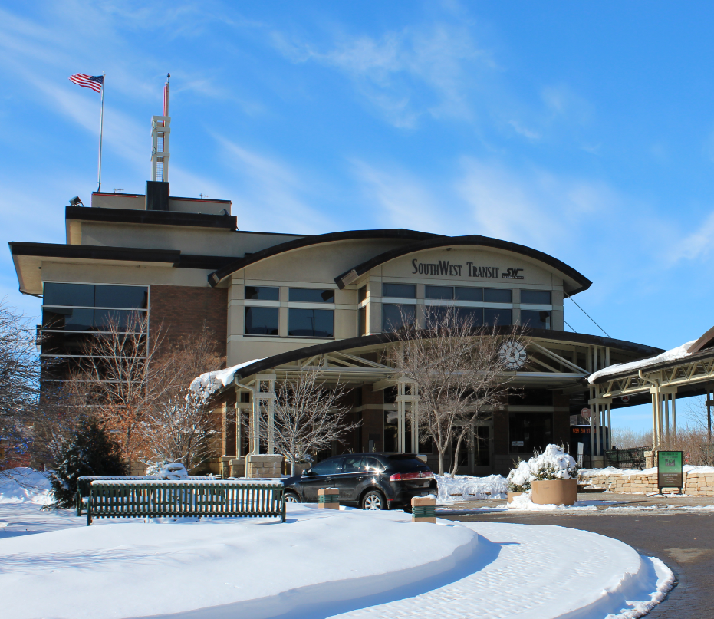
Who We Are
Public Transportation serving southwestern suburbs of Minneapolis: Eden Prairie, Chanhassen, Chaska, Carver, and Victoria
Over 1,000,000 rides annually
90% Fixed Route
10% Microtransit
Large majority of ridership is park and ride express trips to/from downtown Minneapolis and the University of Minnesota
Multiple Real Estate holdings
First suburban TOD in the region
State and National award winner
Motto - “Expect the Best”

Slide 3
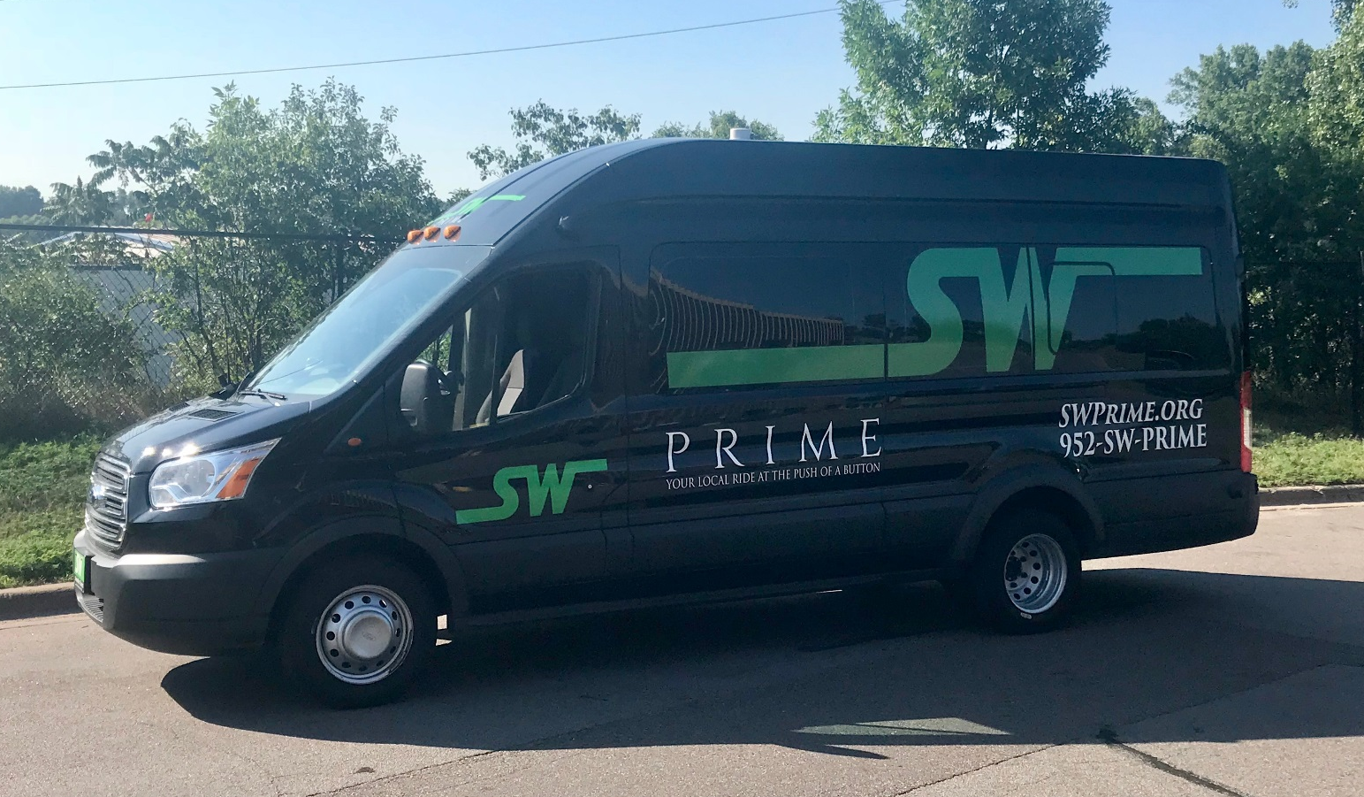
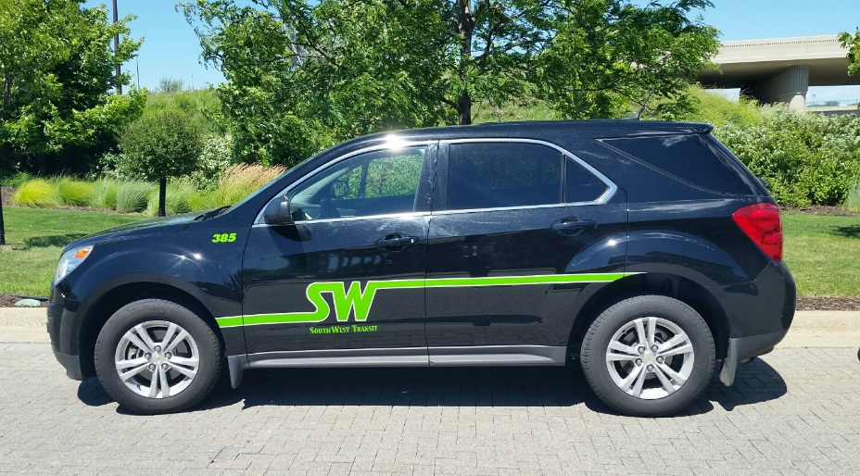
SW PRIME FLEET

Slide 4
WHAT IS SW PRIME?
First of its kind shared ride microtransit service in Minnesota. Service began operating in 2015.
The general public can request a ride on demand only. No advanced scheduling.
Curb-to-curb service.
Serving Eden Prairie, Chanhassen, Chaska, Victoria and Carver (Southdale Transit Center on Saturdays).
Scheduling software (Ridecell) used to book and route the rides.

Slide 5
WHY PRIME?
Need for a lower cost local service option (two times rule).
Prior attempts at traditional circulators/demand-response services were cost prohibitive.
Increase in demand for first mile/last mile services.
Need for local service with minimal support staff.
Technology evolution.
Tech-savvy service area population.
Long track record of service innovation.
Willingness to take a risk.

Slide 6
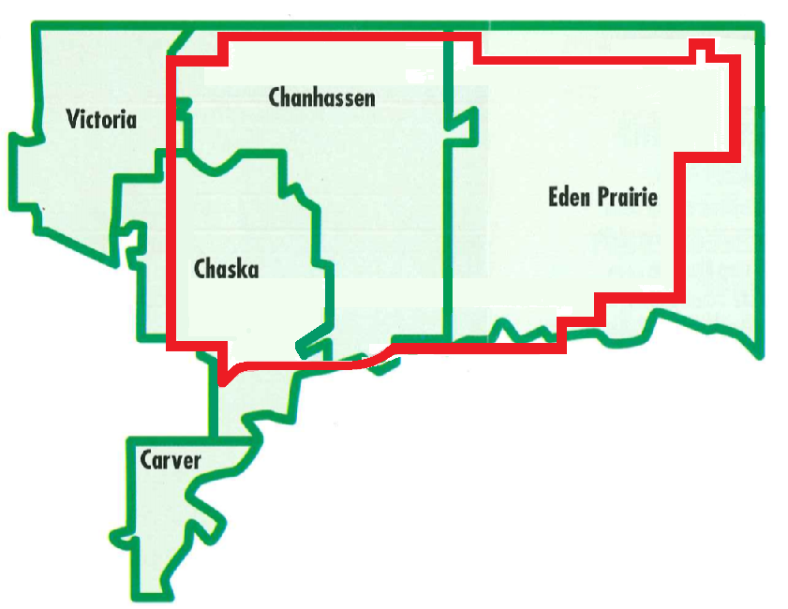
Service Area Statistics
Population: 118,588 (Minneapolis: 413,651)
89.8 Square Miles (Minneapolis: 58.4)
72,095 Jobs (Minneapolis:324,017)
Average Median HH Income over $100,000 (Minneapolis: $73,231)

Slide 7
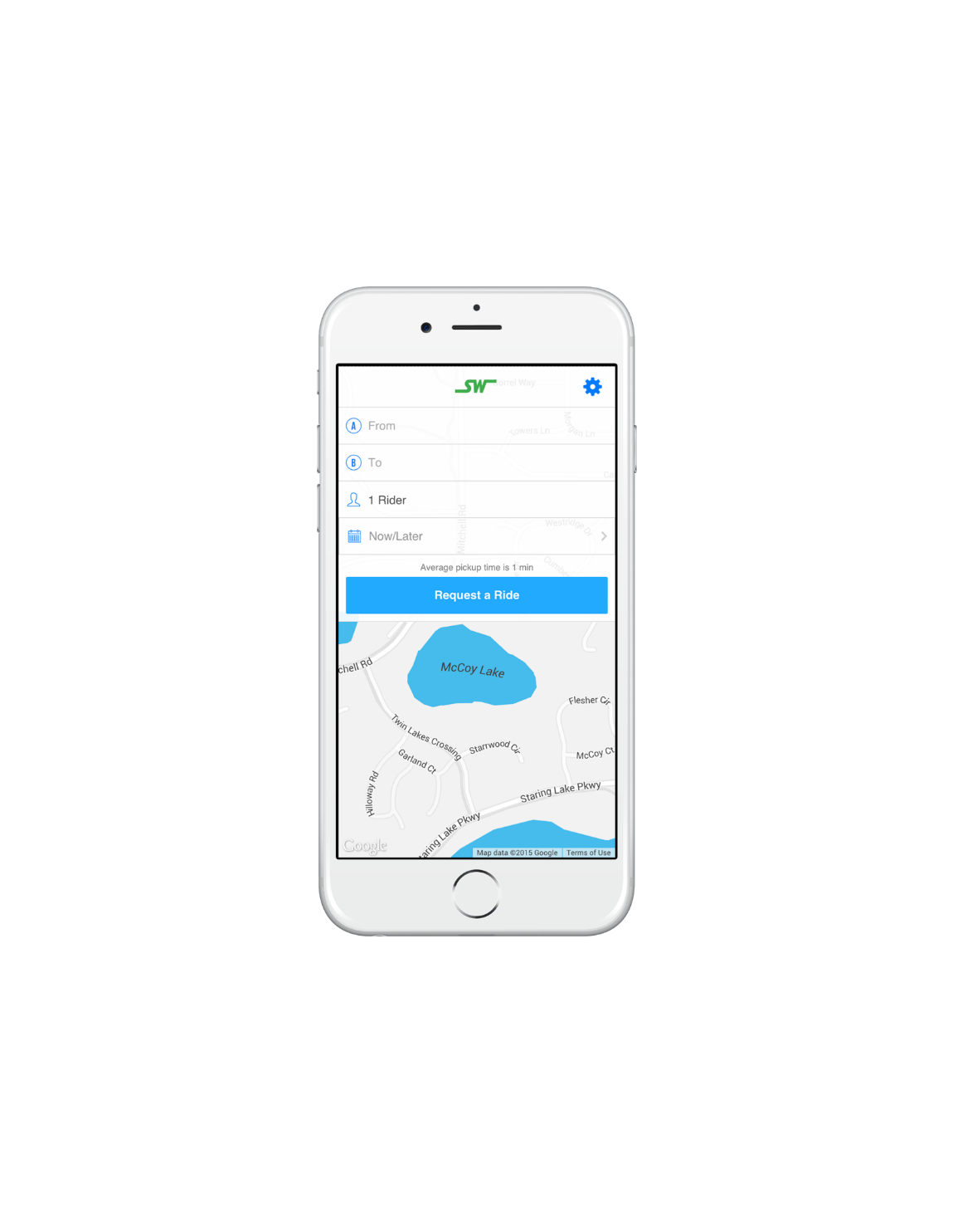
How do I book a PRIME ride?
1. By Phone
2. Using your app; and
3. Using your computer
Rides booked within 20 seconds.
Rides are confirmed automatically via text/phone call.
Track vehicle location live using the app.
Notifications sent automatically upon vehicle arrival.

Slide 8
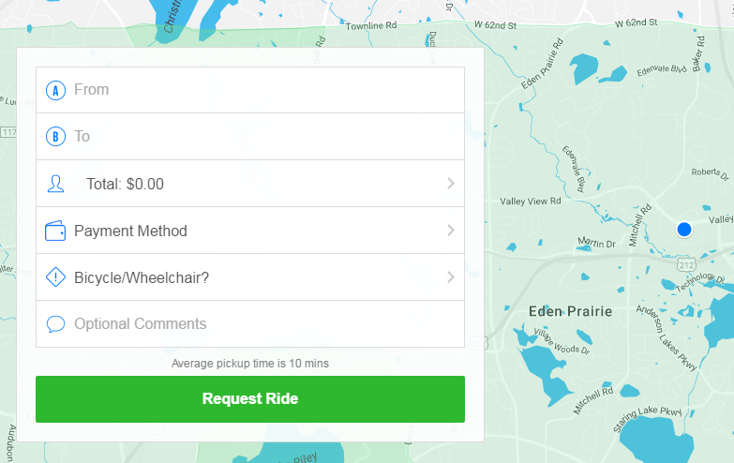
App Screen View
Computer Screen View

Slide 9
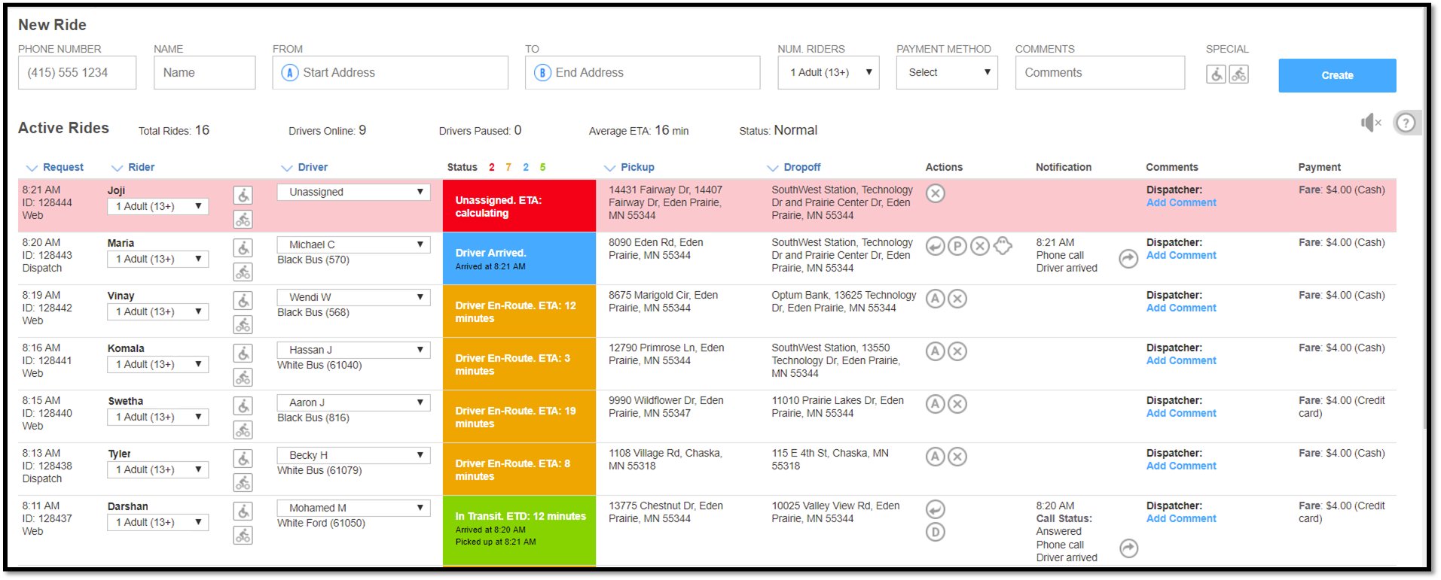
Dispatch Screen View

Slide 10
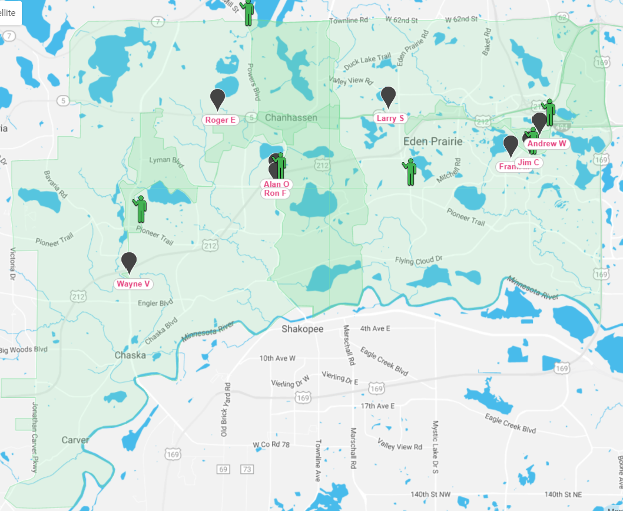
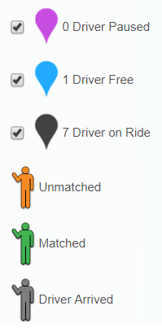

Slide 11
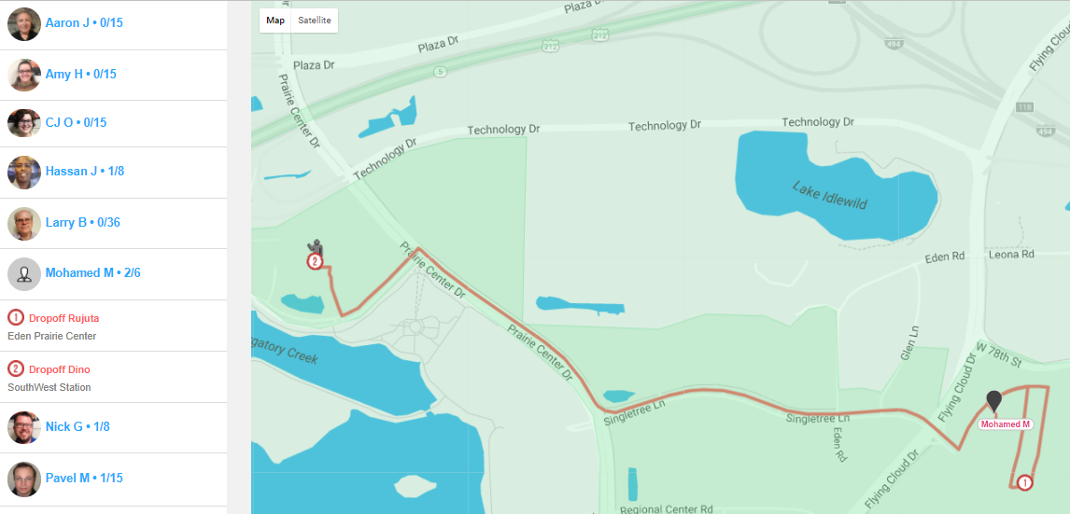

Slide 12
SW PRIME SERVICE INFORMATION
SW Prime service is available Monday – Friday: 6:30 am (First Pickup) – 6:30 pm (Last Pick Up); Saturday 8am – 6pm (Includes Southdale Mall)
No new reservations will be taken after 6:00pm
Each ride is booked separately, meaning each leg of the trip is considered one ride
$4.00 per adult, per ride.
$3.00 for kids between the ages 6 and 12 when accompanied by a paying adult (18 years of age or older).
Free for kids 5 and under when accompanied by a paying adult (18 years of age or older).
$1.00 for seniors on Mondays
Free transfers to and from SouthWest Transit express services.

Slide 13
What Makes Prime Efficient?
Entry level operator wages
Technology
Web requests minimizes booking time
Allows for just one dispatcher to oversee system
Automatic driver assignment
On bus technology that routes trips efficiently
Various payment options including online and on-bus credit card transactions speeds up boarding time
Embedded mid-point transfer (off-peak) to ensure geographical vehicle balance
Strict No-Show Policy

Slide 14
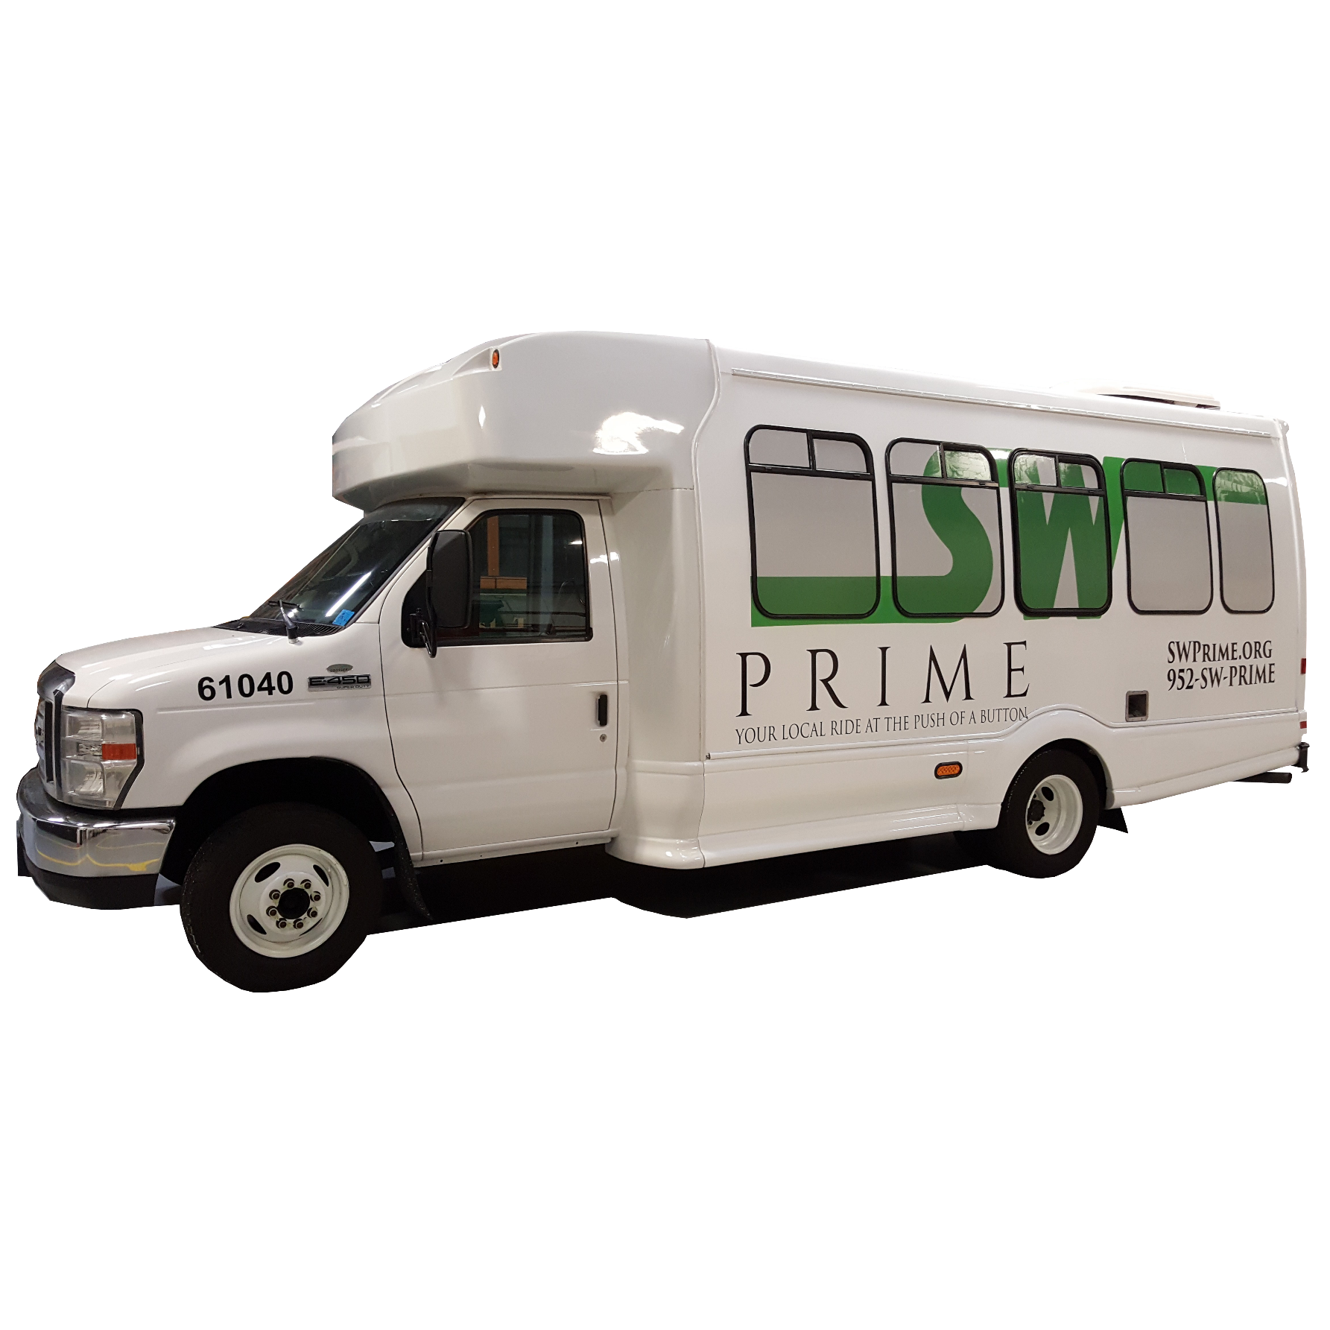
Prime Performance September 2018
Average Ride Time: 15.5 minutes
Average Wait Time: 17.5 minutes
Average Daily Rides: 355
Passengers Per In-Service Hour: 3.9
Peak Buses Used: 12
Average Subsidy Per Passenger: $8.00
Ride Booking Method
60% Online
40% Phone

Slide 15
Prime Performance – Daily Feedback From Rider June 2015 - Today

Slide 16
What’s Next?
Service Expansion
Hours of operation (evenings and weekends)
Service area expansion
Shakopee
494 Corridor
County-Wide Service
Paratransit Services
TNC Partnerships
Electric Vehicles
AV Demonstrations

Slide 17
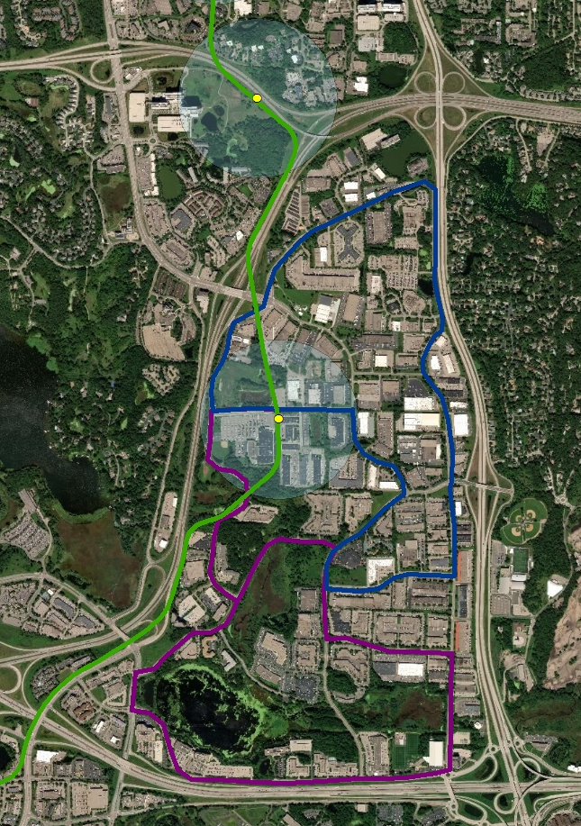
What’s Next? – Golden Triangle Autonomous Demonstration
Eden Prairie’s Golden Triangle Area (GTA)
Largest Suburban Business Park in the Twin Cities Metro Area
20,000+ Jobs
9.8 million sqft. of office, commercial, and industrial property.
Accounts for 9% of all office/industrial space in the Twin Cities
Increased employment density anticipated with SWLRT
Large Employers: Optum, SuperValu, Starkey Labs, Evine, Cigna, Lifetouch Studios
Majority of jobs outside of ¼-mile buffer of planned SWLRT stations

Slide 18
Questions?
Dave Jacobson
Chief Operating Officer
SouthWest Transit
djacobson@swtransit.org
952-974-3110
Charlie Cochrane
Transit Planner
SouthWest Transit
ccochrane@swtransit.org
952-974-3130

